Slide 1
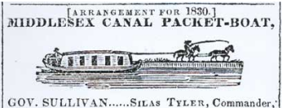
Lowell Middlesex Canal Park Cross Point to Merrimack
Rev 0, 10/18/2023
Another Continuation Idea for the BFRT into Lowell
Presentation to the Chelmsford BPAC
19 October 2023
EARLY CONCEPT
Doug Chandler
Chelmsford Rep to
Middlesex Canal Commission

Slide 2
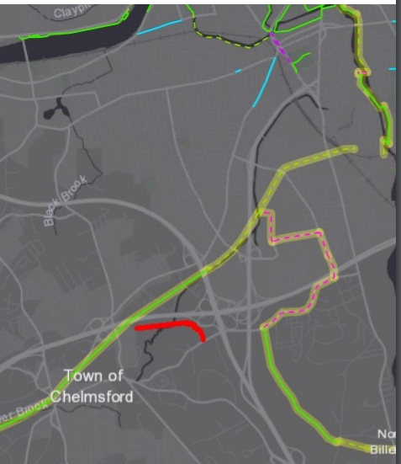
Review: Area Trails and Plans
To BCT to Newburyport
Concord River Greenway
HadleyPark
New Trail Bridge
110
Railroad yard gap (Pete Sutton idea)
Black Brook
MassDOT Plan ~ 1 mile of city streets + crossing active rail yard
Golf Course
3
Old MassDOT Plan ~ 1 mile of city streets + 1 mile of busy country road
110
Old Canal Bed
495
495
Canal St
Middlesex Canal
Trails Legend Existing
In progress
Proposed
Background
BFRT
3
Riverneck Idea
~ 1 mile of woods trail
+ ½ mile of bike lane
To Yankee Doodle Trail

Slide 3
Latest Idea - Northern Continuation of BFRT and Canal Towpath Trail

Slide 4
Backing & Funding
Sen. Kennedy would like to see the Middlesex Canal section in Lowell commemorated by a park, nature trail, multi-use path etc.
Old canal is now a water hazard on the golf course
South of GC is a quarter mile of the best preserved “watered” canal “prism” in 26 miles
To south, canal is under swamp or highway
To east, there are two Lowell schools that would benefit from nature trail and shortcuts for kids
Funding would be from federal and state grants via Rep Trahan

Slide 5
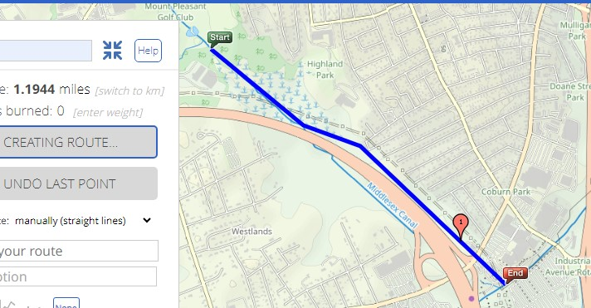
Overall: Cross Point BFRT to Golf Course = 1.2 miles

Slide 6
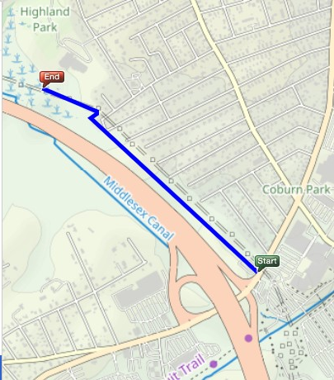
Easy Trail: Via Pipeline & Powerline, 110 to Swamp = 0.7 miles
Pipeline (west path):
OK as is for walking/running or mountain bike
Six 1-foot stream jumps
Enter from Alpine Butcher
Powerline(east ROW):
Flat and level but overgrown
Enter behind brick pump house Run together in some places
Either one is almost as good as a railroad right of way
Choice depends on - land ownership, - easement,
- safety rules
School
Stevens St
3
110
Powerline
Pipeline
110
3
BFRT

Slide 7
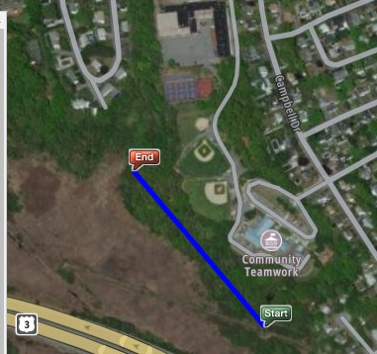
Easy Park and Nature Trail: Swamp to Schools = 0.3 miles
Flat woods:
- Above the waterline
- Downhill from schools and baseball fields
- About 1000x200 feet
- Good for nature trail, park, picnic, etc
- Well-worn easy path from “Start” from “Start” to nearest school
Owned by City and Eastern Salt Co

Slide 8
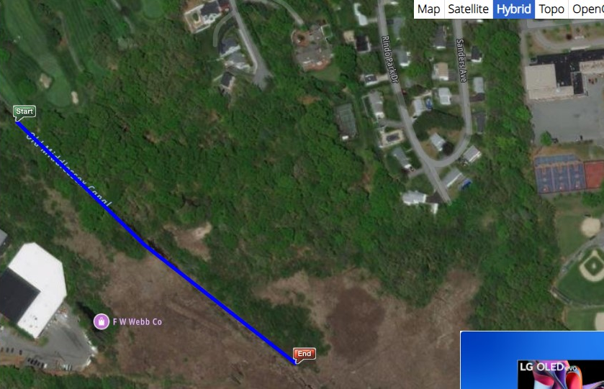
Hard Trail: Schools to Local Streets or Canal = 0.3 miles
Hard to find a route:
- Above the waterline
- Downhill from schools/fields
- Gentle for bike path
More exploration needed
Golf Course
Wet
Not Yet
Dirt Road
Good Towpath
Steep
Wet
OK
Not Yet

Slide 9
Summary
This is just early concept work
Multi-use trail from 110 to schools, with park and nature trail, looks relatively easy
More exploration needed at north end
Wet or steep terrain
Nothing much to see north of the golf course

