Slide 1
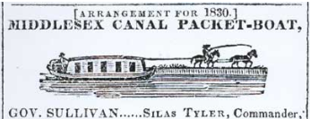
Lowell Middlesex Canal Park Cross Point to Merrimack
Rev 3e, 10/21/2025
Another Continuation Idea for the BFRT into Lowell
For Presentation to the Chelmsford BPAC
19 October 2023
EARLY CONCEPT
Doug Chandler
Chelmsford Rep to
Middlesex Canal Commission

Slide 2
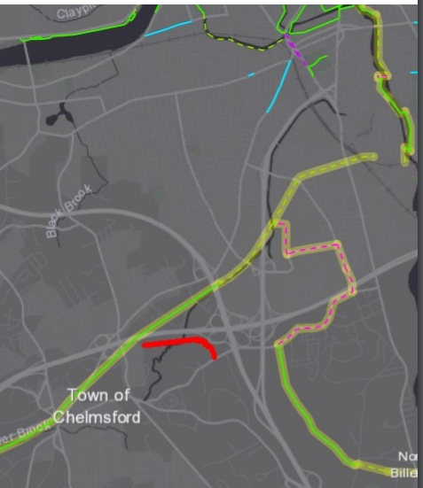
Review: Area Trails and Plans
To BCT to Newburyport
Canal N end
Concord River Greenway
Hadley Park
New Trail Bridge
Railroad yard gap
Black Brook
110
Pete Sutton idea
MassDOT Plan ~ 1 mile of city streets + crossing active rail yard
Golf Course
3
Old MassDOT Plan ~ 1 mile of city streets + 1 mile of busy country road
110
Old Canal Bed
495
495
Canal St
Middlesex Canal
Trails Legend Existing
In progress
Proposed
Background
BFRT
3
Riverneck Idea
~ 1 mile of woods trail
+ ½ mile of bike lane
To Yankee Doodle Trail

Slide 3
Latest Idea - Continuation of BFRT and Canal Towpath Trail in Lowell
Roark Bridge
Hadley Park
Mount Trashmore
Stedman St
Route 3
Connector
Swamps, not lakes
110

Slide 4
Backing & Funding
Sen. Kennedy asked the Middlesex Canal Commission to help plan a park, nature trail, multi-use path etc. to commemorate the Middlesex Canal section in Lowell
North, the old canal is now a water hazard on the golf course
South of GC is a quarter mile of the best preserved canal in 26 miles, with water and towpath
In the middle, the canal is now under swamp and Route 3
To east, there are two Lowell schools that would benefit from nature trail and shortcuts for neighborhood kids
South of the swamp is excellent ROW for a multi-use path to 110
Funding would be from federal and state grants via Rep Trahan

Slide 5
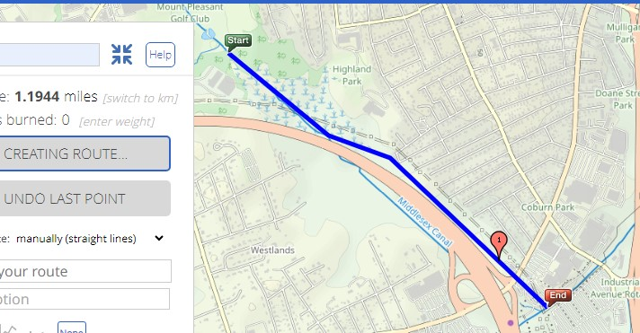
Overall: Cross Point BFRT to Golf Course = 1.2 miles
Almost all land involved is owned by the city, electric companies, or Eastern Salt Co
Details on following charts

Slide 6
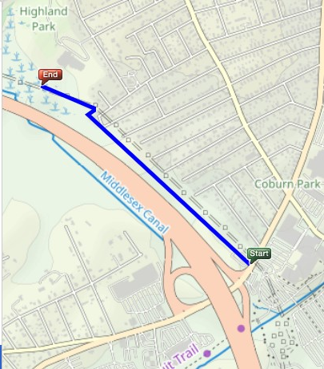
Easy Trail: Via Pipeline & Powerline, 110 to Swamp = 0.7 miles
Starts just across the Cross Point parking lot from east end of BFRT
Pipeline (west route):
OK as is for walking/running or mountain bike
Six 1-2 foot stream jumps
Enter from Alpine Butcher
Powerline (east route):
Flat and level but overgrown
Enter behind brick pump house Paths overlap in some places
Either one is almost as good as a railroad right of way to build on
Choice depends on easements and safety rules
All land owned by City or Electric Co
Schools
Stevens St
3
110
Powerline
Pipeline
110
3
BFRT

Slide 7
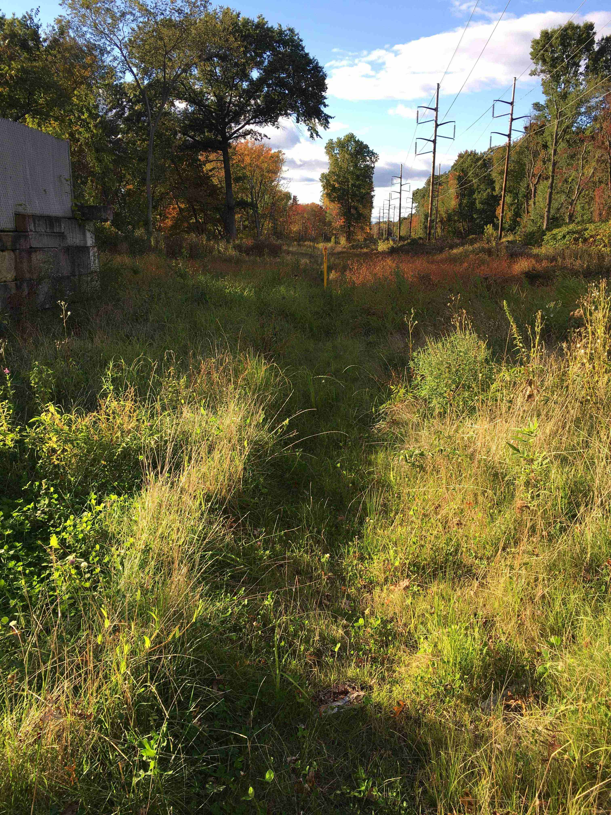
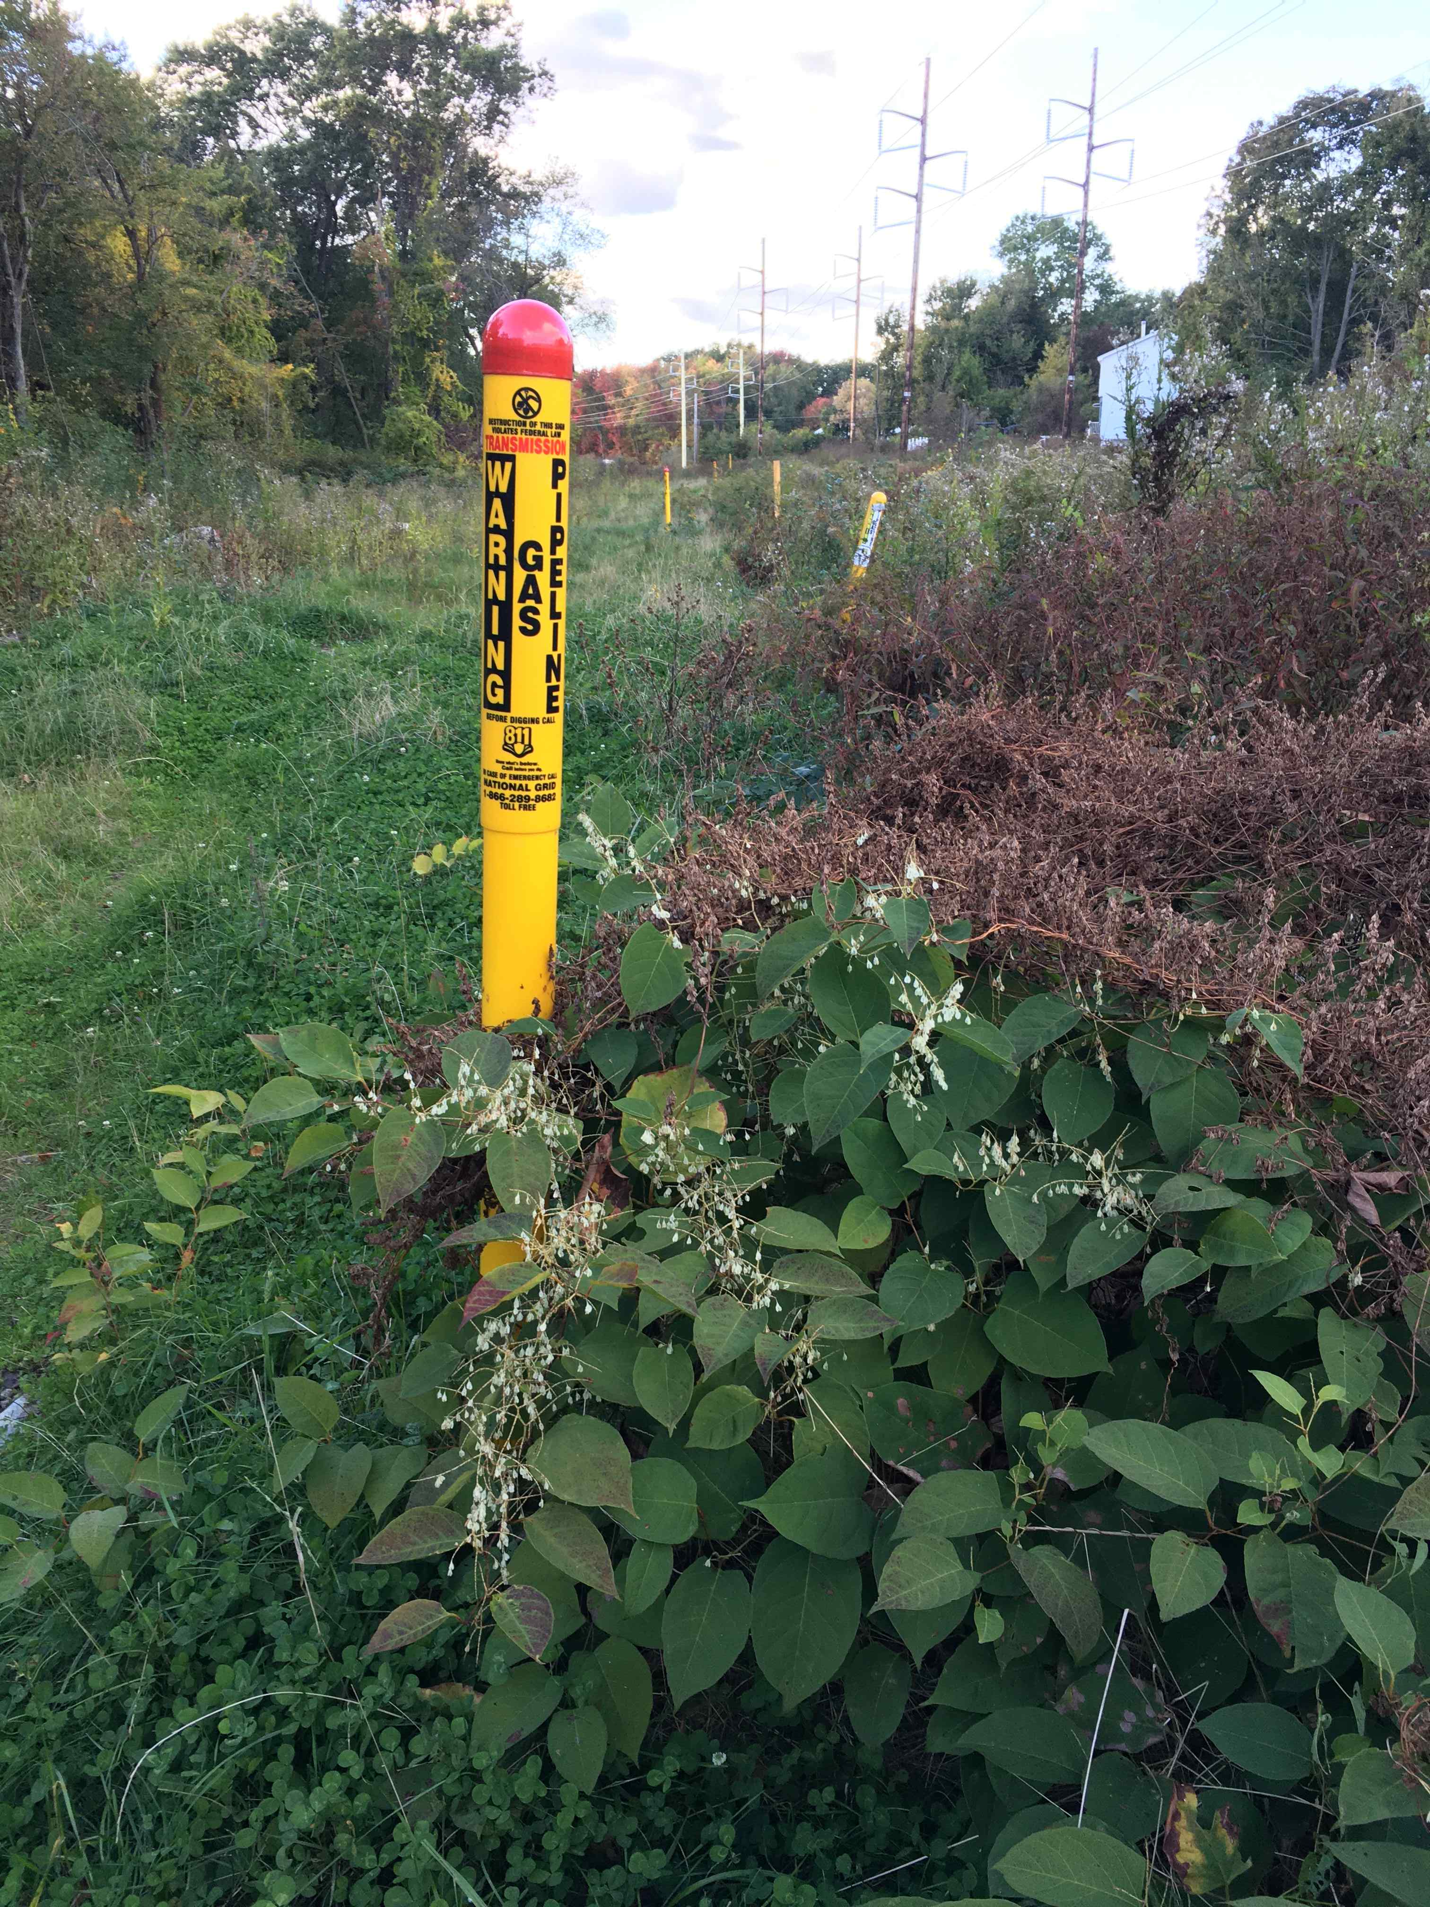
Pipeline & Powerline Route

Slide 8
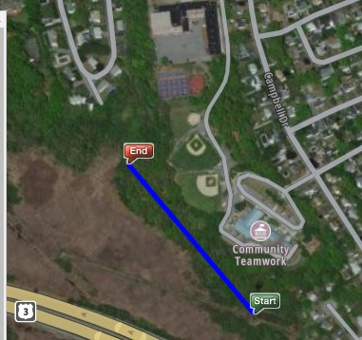
Easy Park and Nature Trail: Swamp to Schools = 0.3 miles
Flat woods:
- Above the waterline
- Downhill from schools and ball fields
- About 1000x200 feet (5 acres)
- Good for nature trail, park, picnic, etc
- Well-worn easy paths already --“Start” to Bailey School --“End” to ball fields
Land owned by City of Lowell
Daley
School
Bailey School

Slide 9
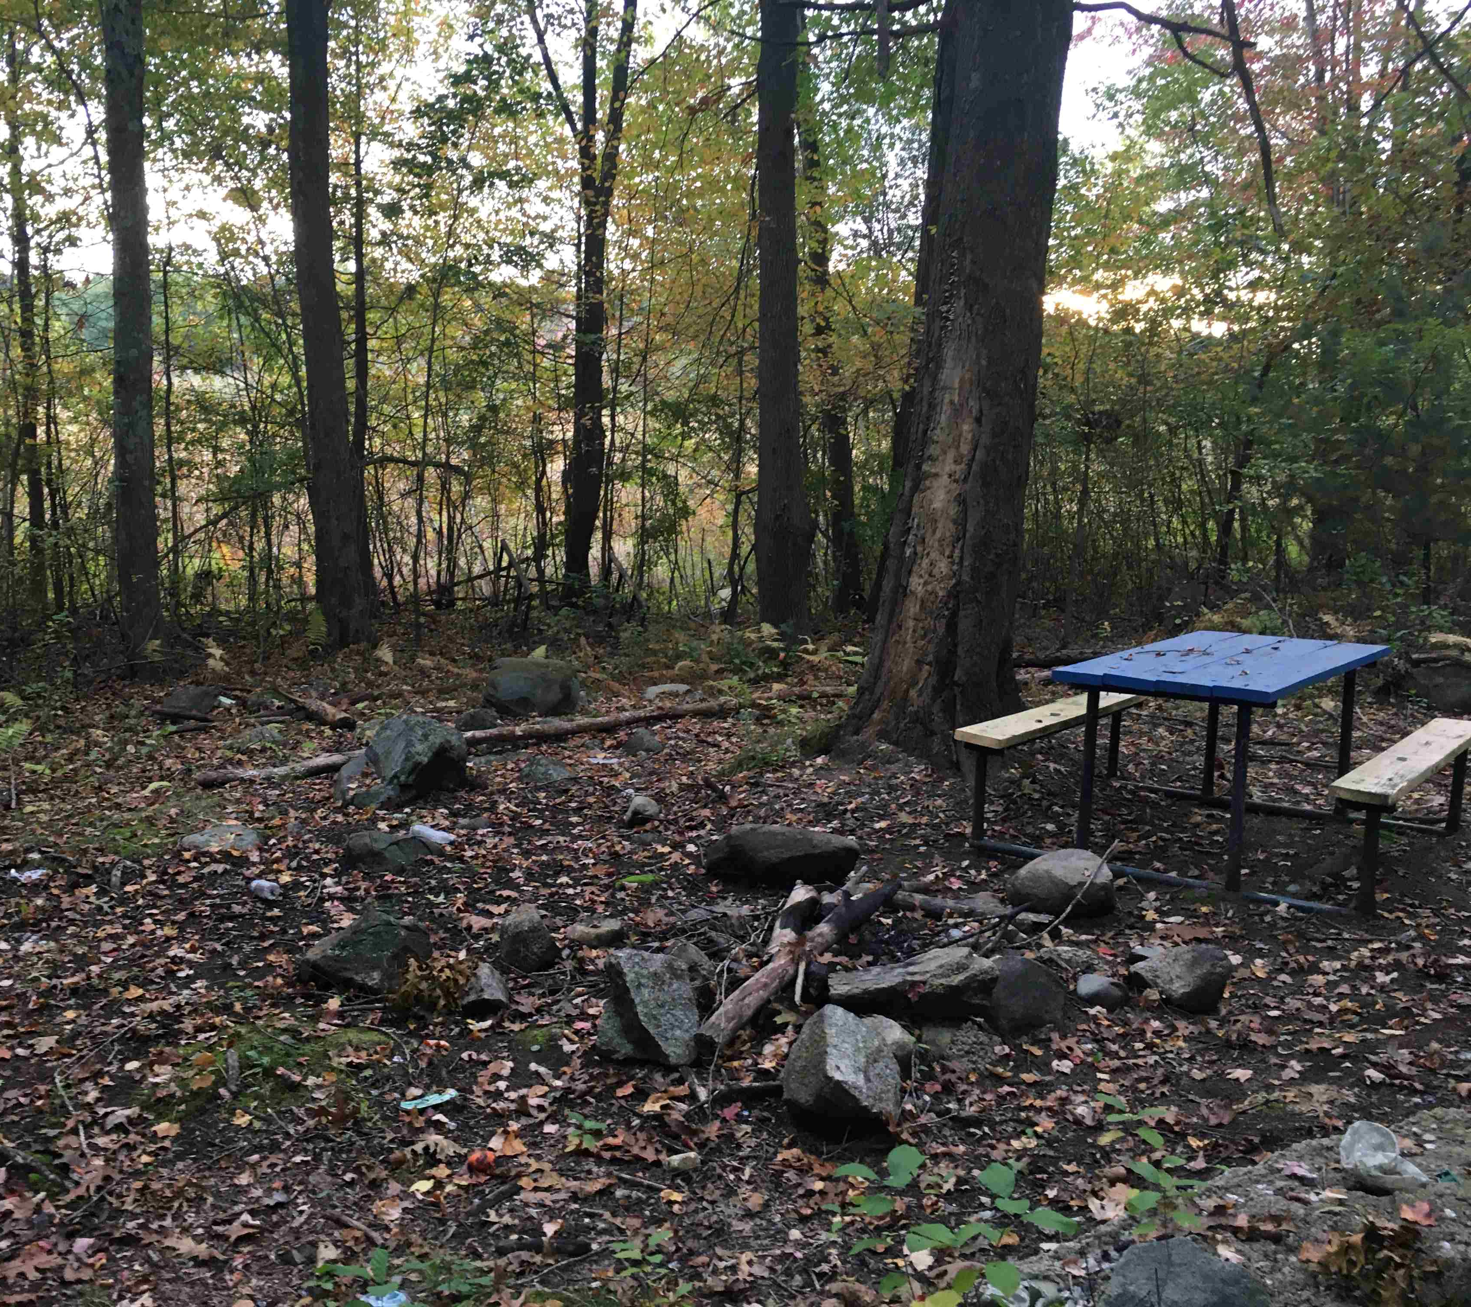
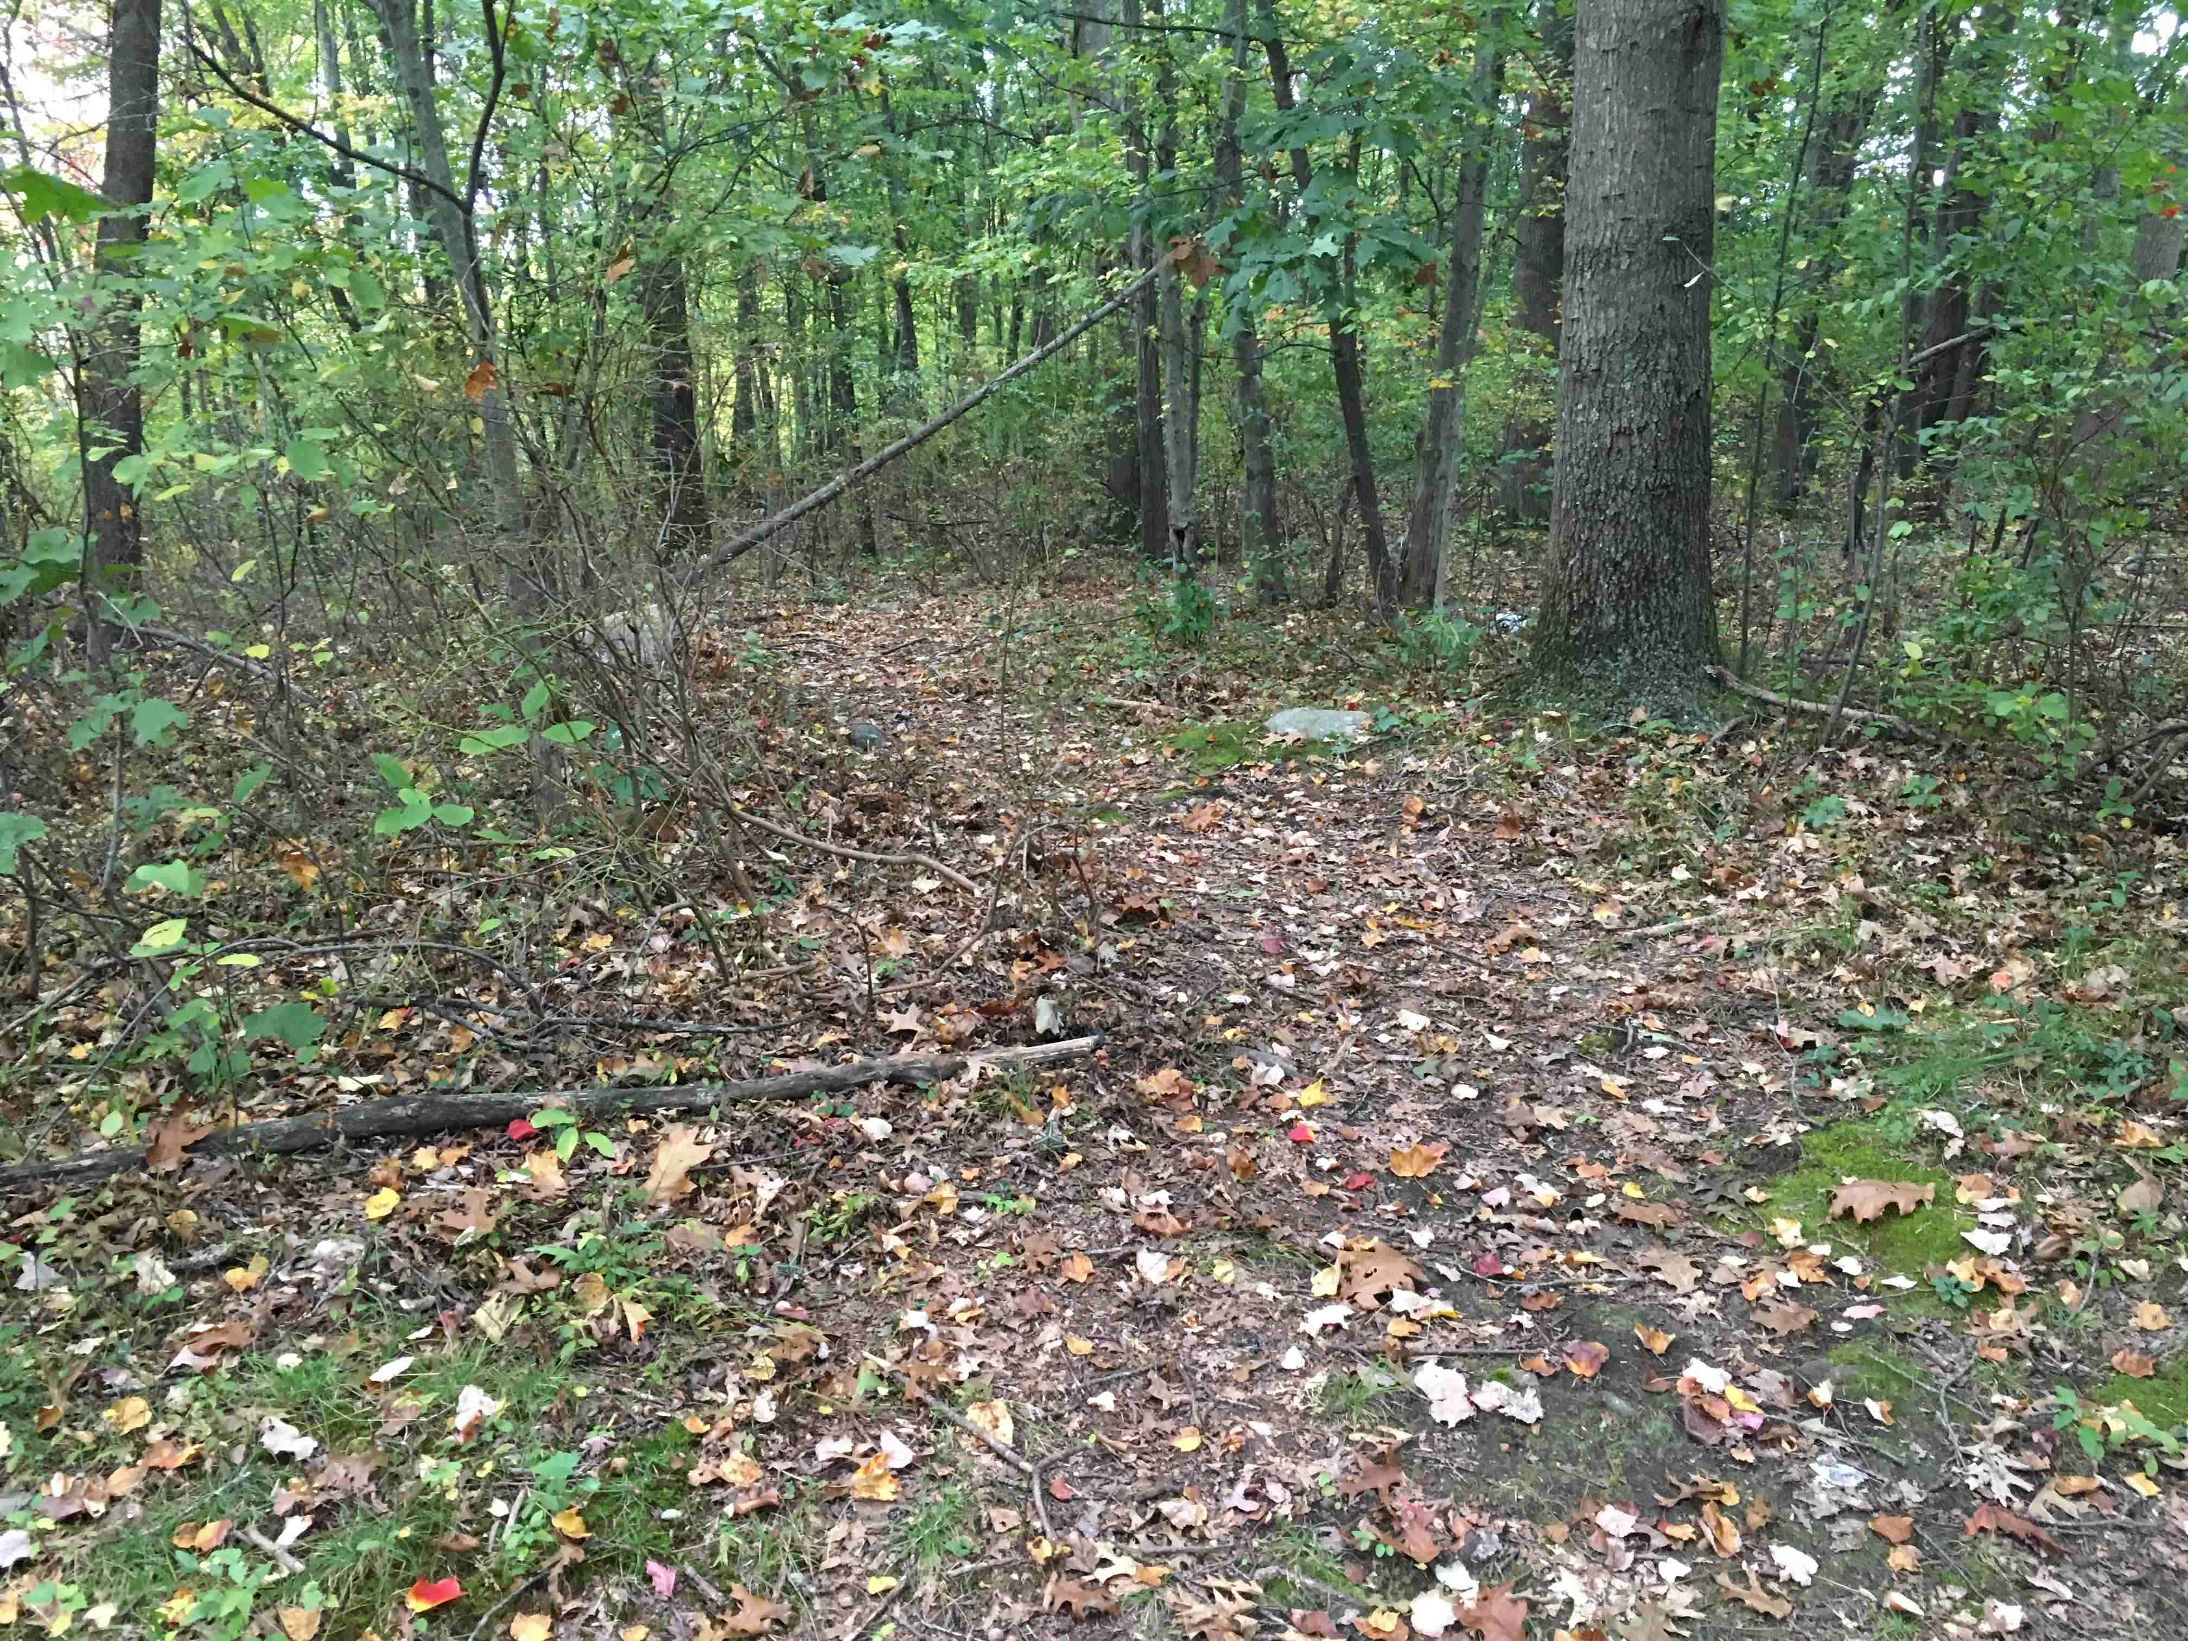
Park & Nature Trail

Slide 10
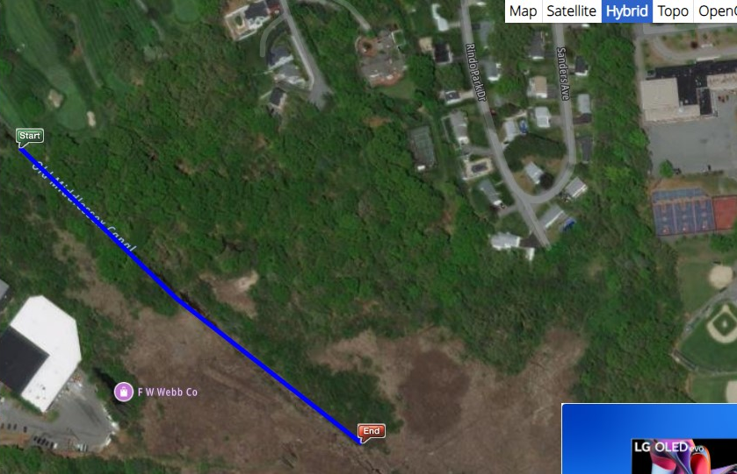
Hard Trail: Schools to Local Streets or Canal = 0.3 miles
Westview
Rindo Park
Sanders
East side - Hard to find a good route that is:
- Above the waterline
- Flat, smooth, and gentle enough for bike path
West side – 3 possible not perfect routes:
- #1 to Westview
- #2 to canal
- #3 side trip to canal
Land owned by:
- City
- Eastern Salt Co
- a few private owners
Golf Course
#1
Wet
Flat, dry, open
Dirt Road
Steep
Good Towpath
#2
Wet
Flat, dry, open
Wet
OK
Wet
#3
Open swamp
Open swamp

Slide 11
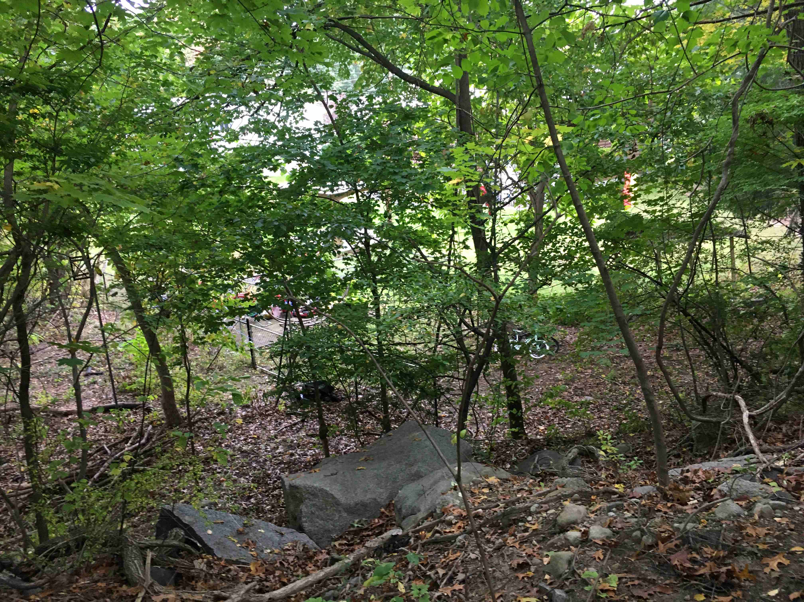
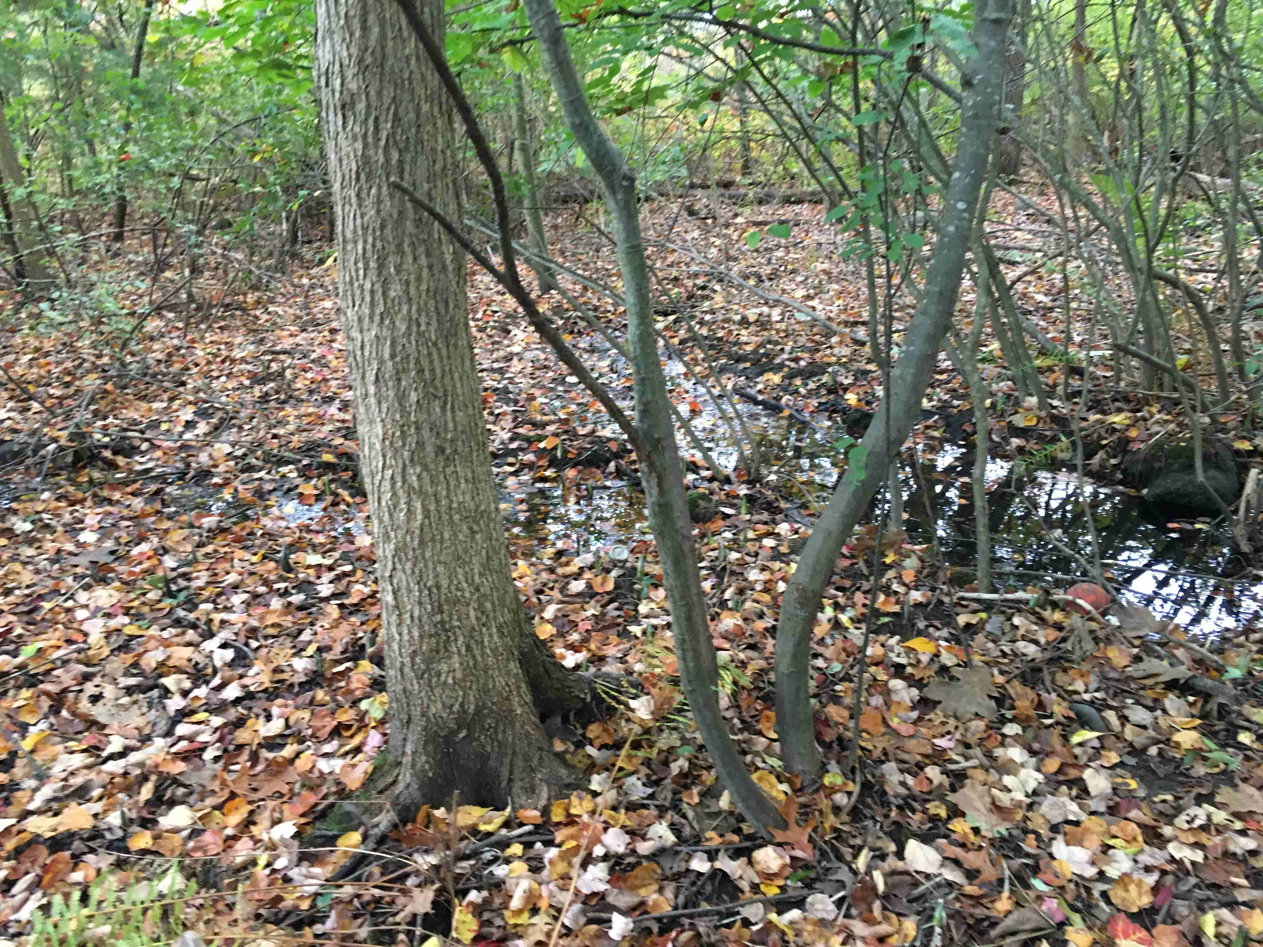
Schools to Golf Course
Typical Steep and Rocky
Typical Wet Areas

Slide 12
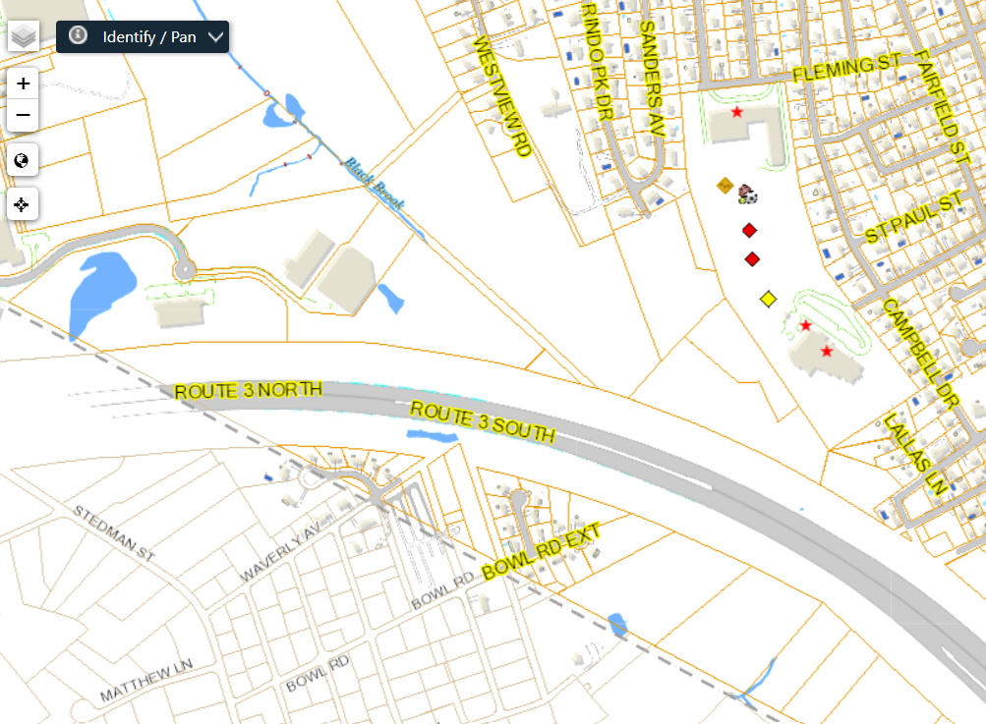
Land Ownership: Lowell Assessor GIS Map
Priv
GC
GC
Priv
GC
GC
Salt
Priv
GC
GC
None
Priv
McN
GC
GC
Priv
GC
Priv
City
City
Priv
E Salt Co
McN
City
Webb
City
Webb
City
Priv
Webb
None
E Salt Co
City
Chelmsford
None = MA DOT
Priv
City
City
Priv
None = MA DOT
City
Priv
Legend
City = Lowell
GC = Golf Course
Elec = one the electric companies
Priv = Private owner
Salt = Eastern Salt Co
https://www.easternsalt.com/
(McN = McNamee family, said to be owners of Eastern Salt)
Webb = FW Webb Co
None = No data; means public land like city street or state highway
Elec
Elec
City
Elec
Priv
Jay?
Chelmsford
https://gpv.lowellma.gov/public/Viewer.aspx

Slide 13
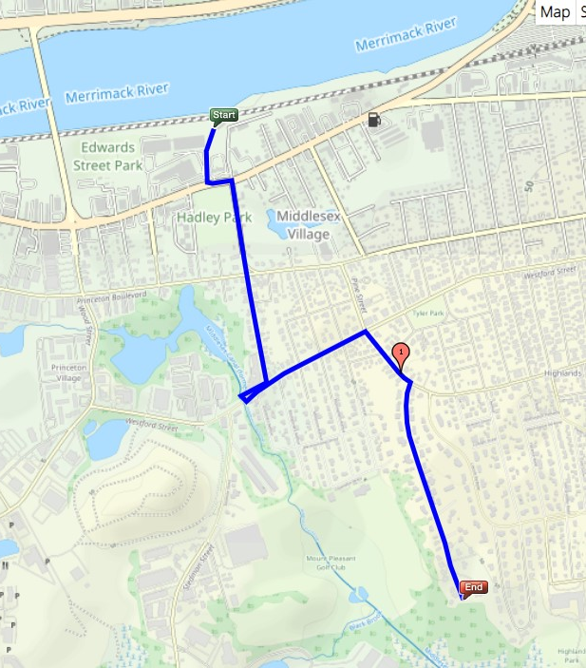
Option #1: Golf Course to Merrimack by City Streets = 1.5 miles
- New fence blocks access to railroad tracks and river
- Auto parts parking has filled in canal
- Hadley Park is about where the canal holding basin was
- Black Brook has carved a new path from GC to river
- Quiet residential streets -- run mostly North-South, in disconnected fingers
- Canal is a golf water hazard
--Visible from clubhouse -- But that’s a half mile detour
Land owned by: All city owned
S Summary
- Hard to find a good route
- Not much to see - But it’s free
Roark Bridge
~ Canal route
Baldwin St
Canal visible
Westview St
Old Dump
- Option 1A: All on streets, free
G C
Stedman St
Steep or wet
Ball Field

Slide 14
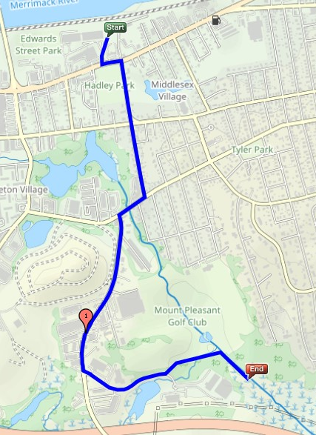
Option #2: via Canal and Stedman St = 1.7 mi
North half is same as Option #1
- Autoparts, Hadley Park, Baldwin St
South Half
- Stedman St onto Olde Canal Drive
- Stay straight into woods trail along south edge of golf course
-Take canal towpath south to beaver dam
- Cross dam and due east on Option #2
- Join dirt road south
- Go around end of Rindo Park to schools
Advantage: Only option that actually sees original canal
Disadvantages: - Stedman is busier than residential streets
- Need easement Olde Canal to old canal
Roark Bridge
Hadley Park
Canal route
Baldwin St
Canal visible
Old Dump
Stedman St
Olde Canal Dr
Bear left on woods trail
See chart 10 “Hard Trail Options
“Paper” St

Slide 15
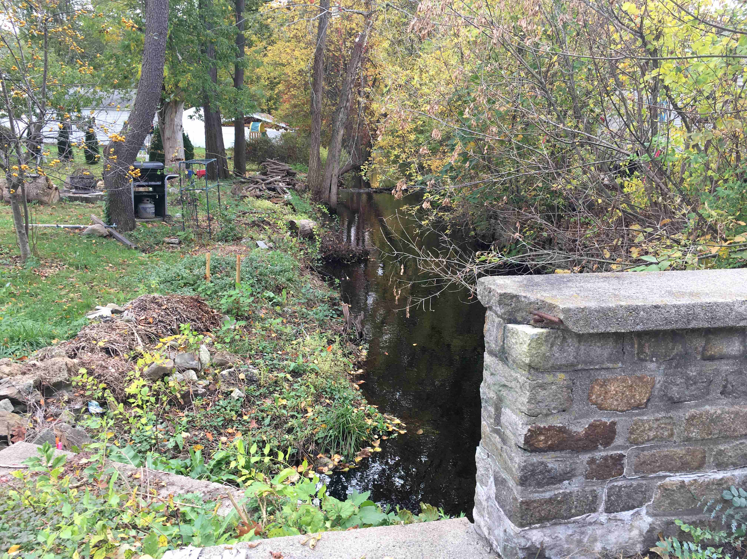
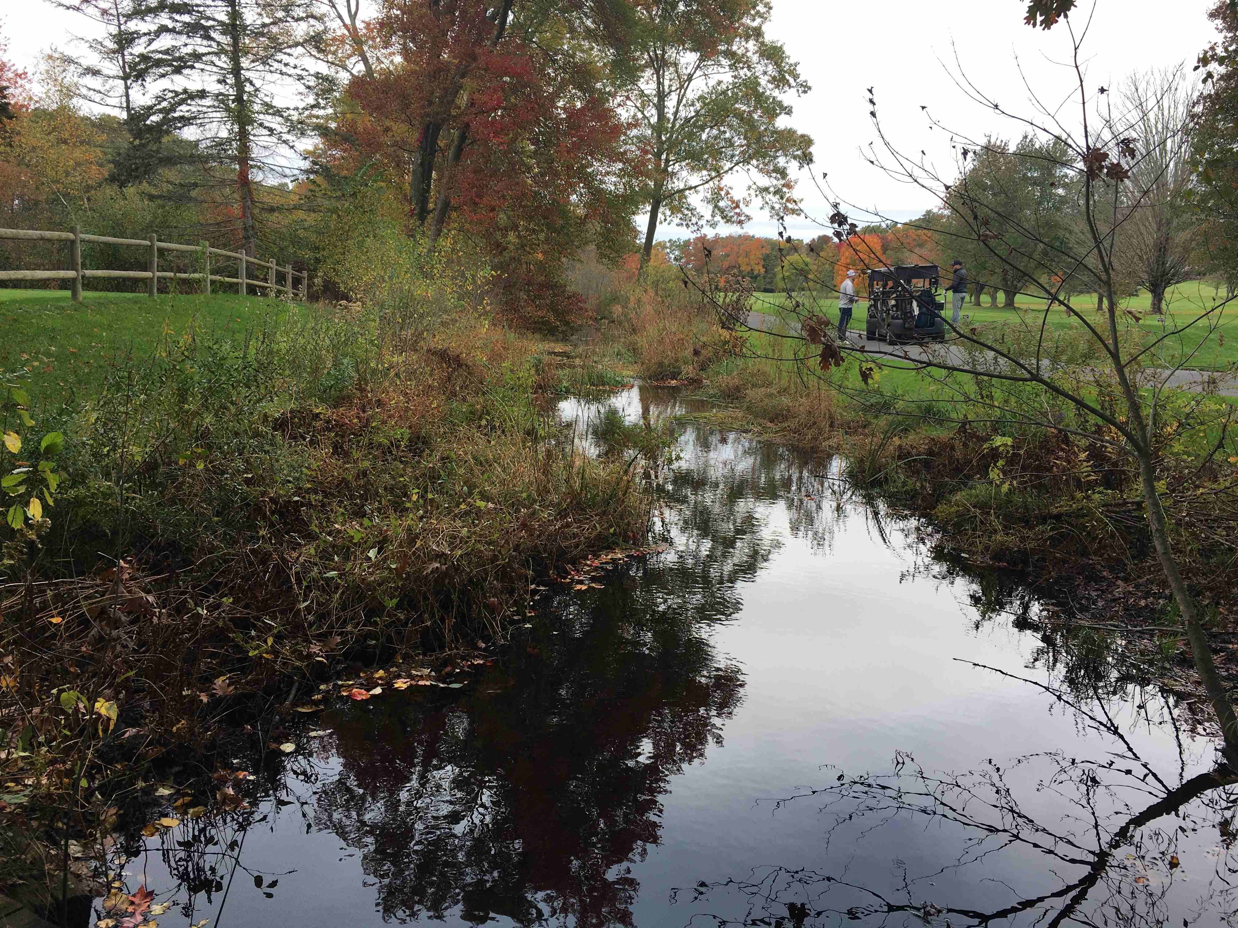
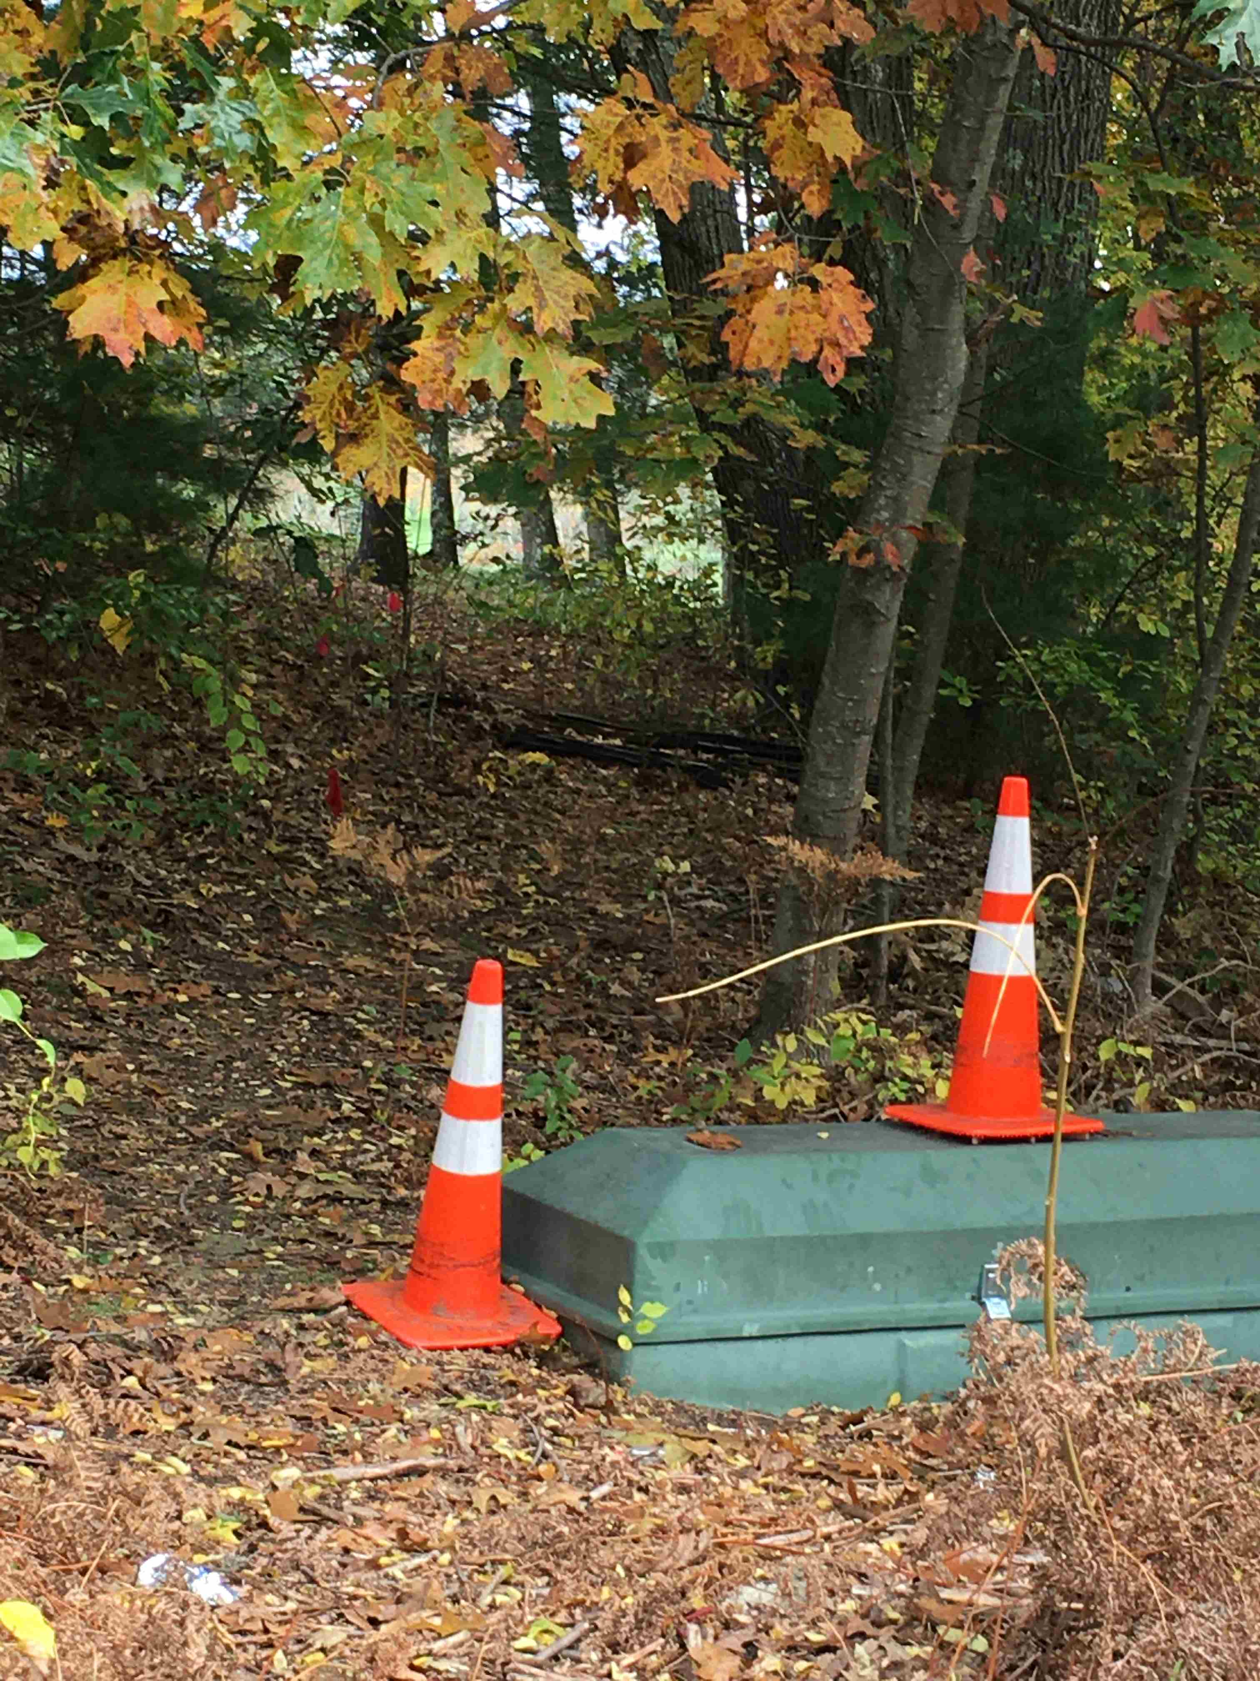
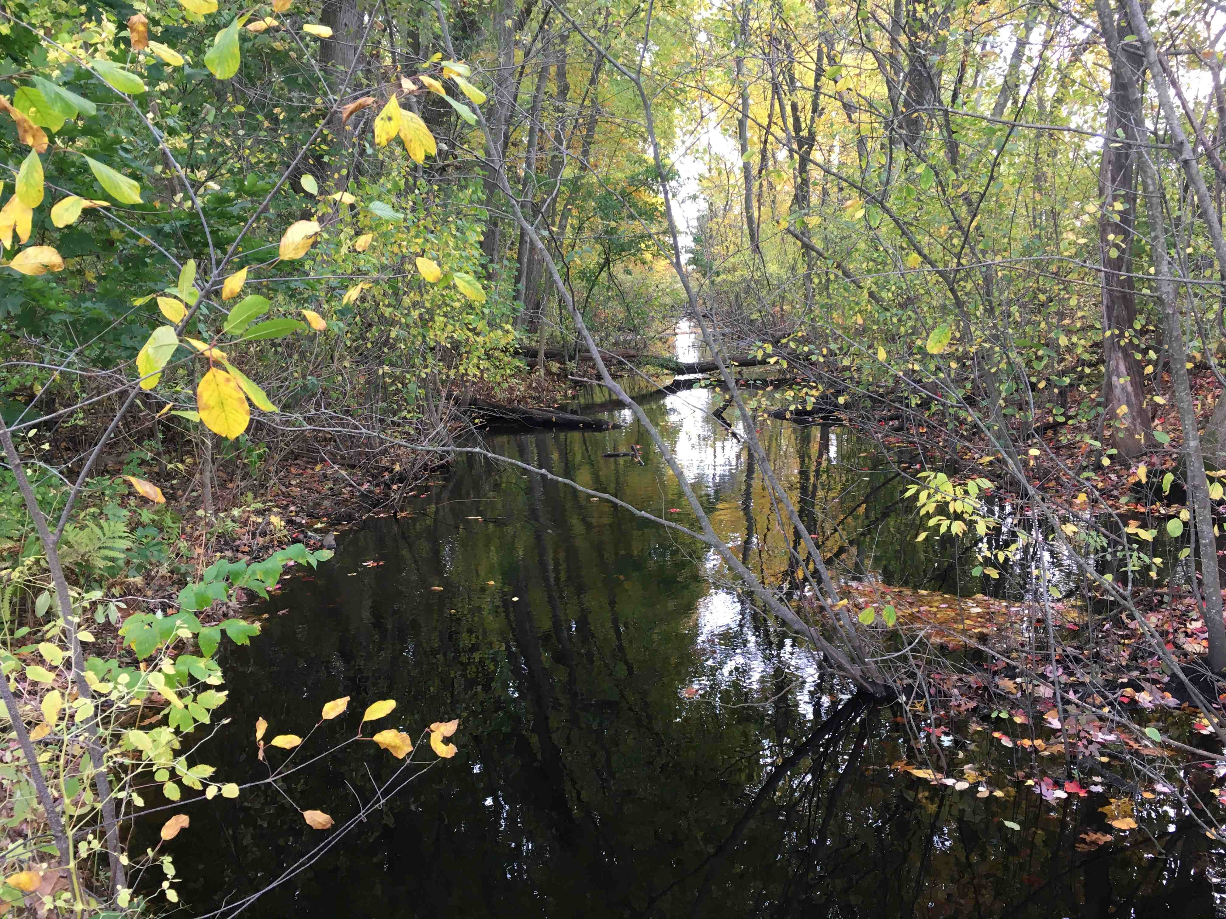
Original Canal with Towpath
Towpath Side
Canal S from Westford St
Canal North on Golf Course
Paper street to GC
Canal South of Golf Course

Slide 16
Goldilocks Option #3: Canal View and Streets = 1.7 miles
Same as Options 1&2 -- River to Westford St
Same as Option 1
-- Westford & Westview Sts
Easier Westview to canal
-- Two “paper streets”
--- Westview to GC = Salt Co
--- South edge of GC = city
Same as Option 3 -- Ball field to Canal & GC
Advantages
- Only one easement grantor
- Includes great canal section
Land owned by: City and E Salt Co
S
Roark Bridge
~ Canal route
Baldwin St
Canal visible
Westview St
Old Dump
G C
Ball Field
See chart 10

Slide 17
Historic Link to Thoreau
In 1839 Henry David Thoreau took a canoe trip from Concord MA to the Merrimac River and wrote a book * about his travels.
An ardent naturalist, he preferred the natural Concord River over the new canal, but he noted:
"in the lapse of ages, Nature will recover . . . and gradually plant fit shrubs and flowers along its borders. Already the kingfisher sat upon a pine over the water, and the bream and pickerel swam below. Thus all works pass directly out of the hands of the architect into the hands of Nature, to be perfected."
One of the best sections of the canal on which Thoreau journeyed in 1839 still exists in Lowell, mellowed back to nature by the passage of two centuries of benign neglect.
Lowell's proposed MC Heritage Park will memorialize this inspiring author, his trip, and the low cost water transport that made Lowell competitive with Manchester, England.
* “A Week on the Concord and Merrimack Rivers”, 1839

Slide 18
Summary
This is just early concept work
Trail from BFRT to schools looks relatively easy
Includes safe routes to school, a park, and a nature trail
Harder from schools to city streets or canal
Some engineering for wet and steep parts
Three options for northern end
Two include a quarter mile of original canal
Most land is owned by city or the electric companies
A few privately owned parcels may need easement
Canal routes need an easement from Eastern Salt Co.
Encouraging news: This is a family owned company with national HQ on Middle St in downtown Lowell
More work to be done

