Slide 1
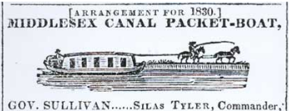
Towpaths to Trails Also Using Railroads and Utilities
See also “Towpaths to Bike Trails R7a 20240218 opening.pptx” for auto slide show warm-up
Rev 8, 2/29/2024
How the Old Canal Towpath and Other Rights of Way Can Bridge Some Gaps in Regional Multi-Use Trails
Presentation to the Quarterly Meeting
Middlesex Canal Association
18 Feb 2024
Doug Chandler
MCA Proprietor
& Chelmsford Rep to
Middlesex Canal Commission

Slide 2
Agenda
Introduction – multi-use trails
Why use existing ROWs?
Middlesex Canal Towpath
Billerica Branch Rail-with-Trail
Power and Gas Lines
Bay Circuit Trail and Local Gaps
Current Projects
1. Riverneck Road proposal aka Thoreau Towpath
2. Lowell Heritage Park proposal
3. Concord River Greenway link
Canal Considerations and Costs
Long Term, This Year, Current Work
Conclusion
Refs
Towpath Topics, various
BayCircuit.org
RailstoTrails.org/towpaths
Wikipedia.org/towpaths

Slide 3
Introduction
Multi-use trails are good for people of all exercise levels from cyclists, wheel chairs, runners, joggers, walkers, and school children to baby carriages
Why are abandoned railroads favorites for bike paths?
Smooth
Level
Wide
Out of motor traffic
Canal towpaths have all the same features!
Powerline and pipeline Rights of Way (ROWs) share most of these features
This talk explores how the Middlesex Canal may fit into regional multi-use trail plans
Mutually benefiting canal awareness and access
Preserving canal borders, by active open space use, from encroachment by development
As well as local biking, walking, and running
MCA members are currently championing three short trail ideas that will link up gaps in the existing regional trail network
An informal group calls itself FORTT = Friends of Regional Trails and Towpaths
Jay Breen, Marlies Henderson, Andrew Jennings, Bill Kuttner, Chris Clark, and Doug Chandler

Slide 4
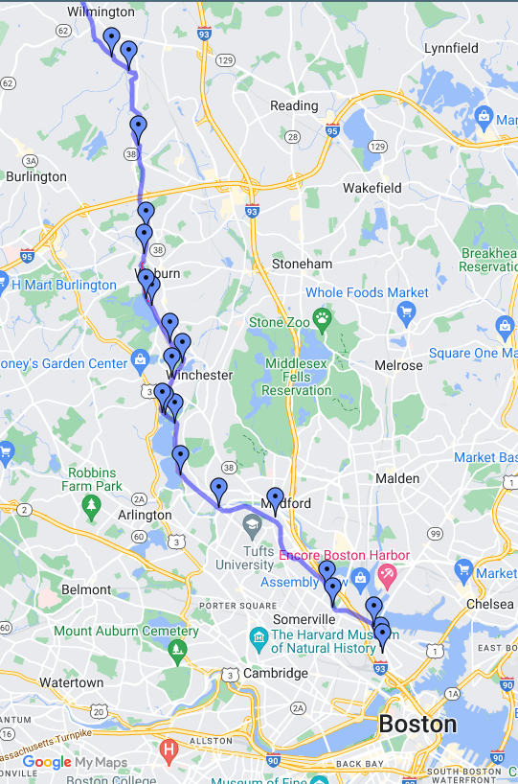
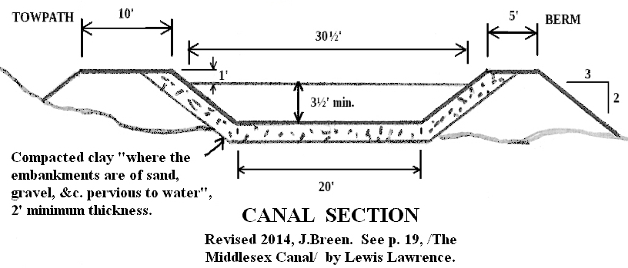
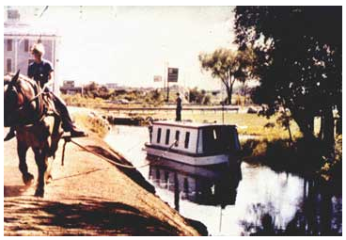
Review: Middlesex Canal Towpath
Connected New Hampshire barge traffic at Middlesex Village (then Chelmsford) 27 miles to Charles River at Boston
Avoided Pawtucket Falls and transferring goods to ocean-going ships to get from Newburyport to Boston
Made the Lowell Mills economically possible
Passed through 9 towns, Lowell to Boston
Active 1803-1853, until eclipsed by faster steam railroad
Some miles of canal, berm, and towpath remain
Towpath makes a great bike path
10 feet wide, totally flat and nearly level
Woburn is starting a multi-use trail on MC towpath
Scale: See mile markers
https://web.archive.org/web/20031027050324/http://library.uml.edu/clh/MC/Mc1.Html

Slide 5
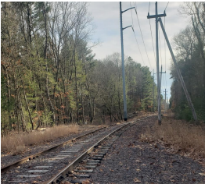
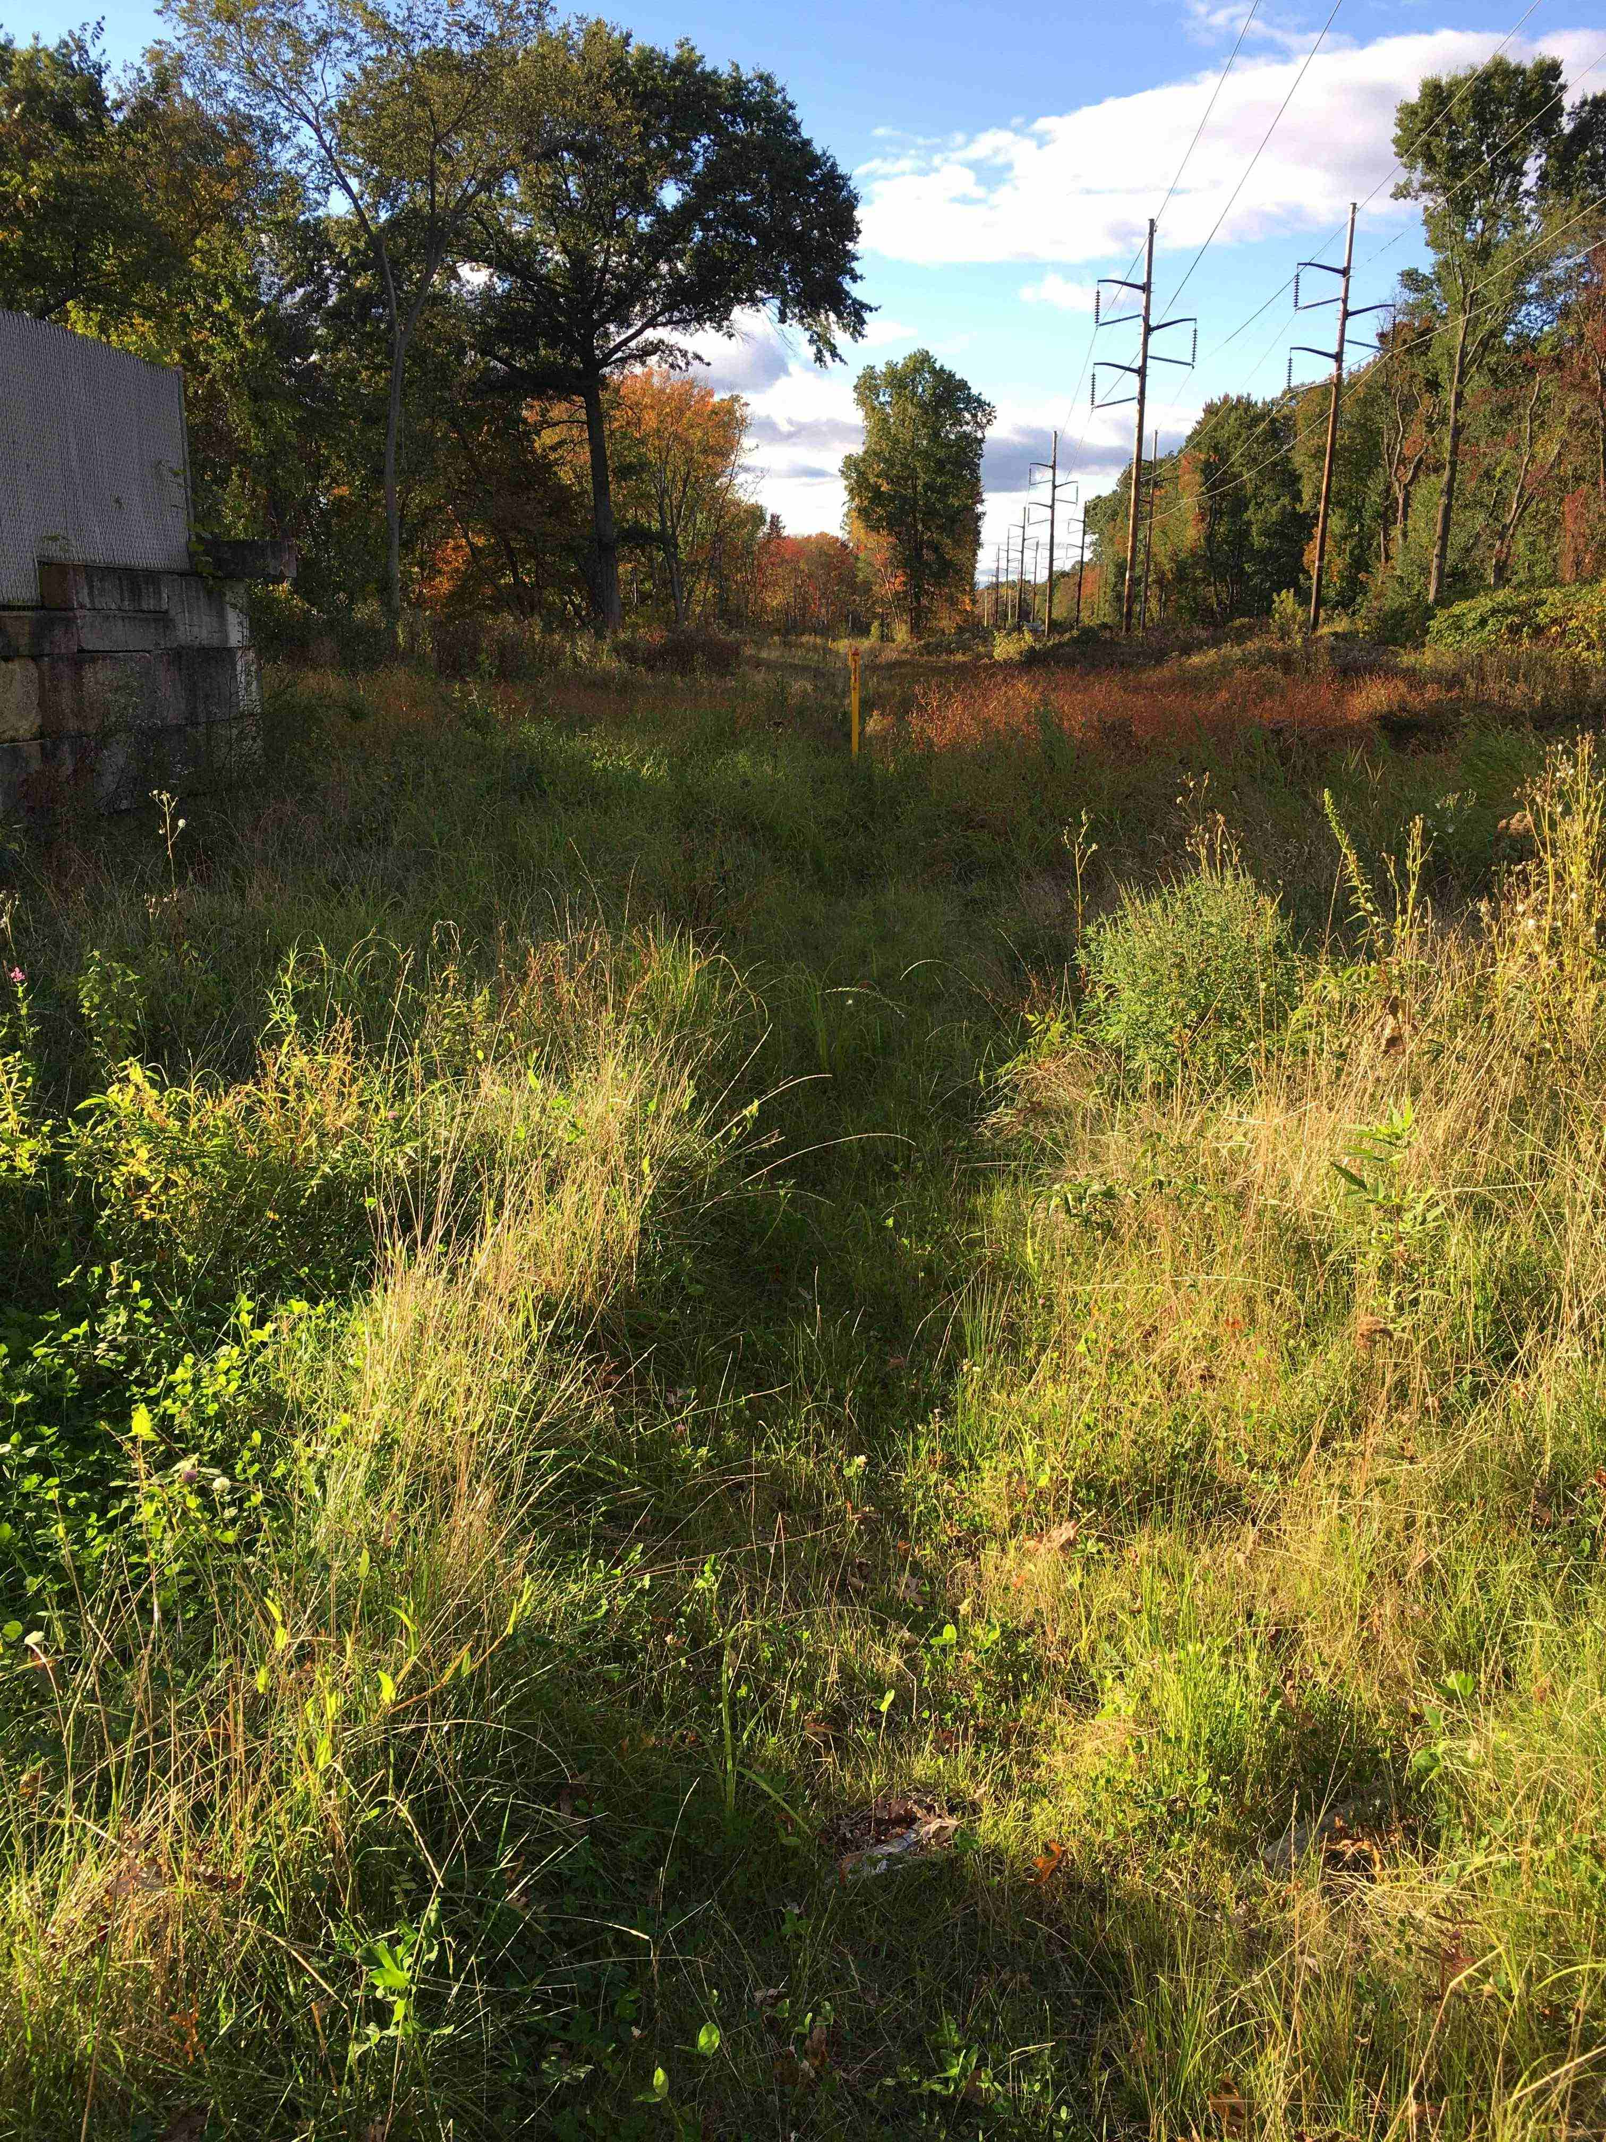
Other Rights of Way
Billerica Branch Railroad Power and Gas lines

Slide 6
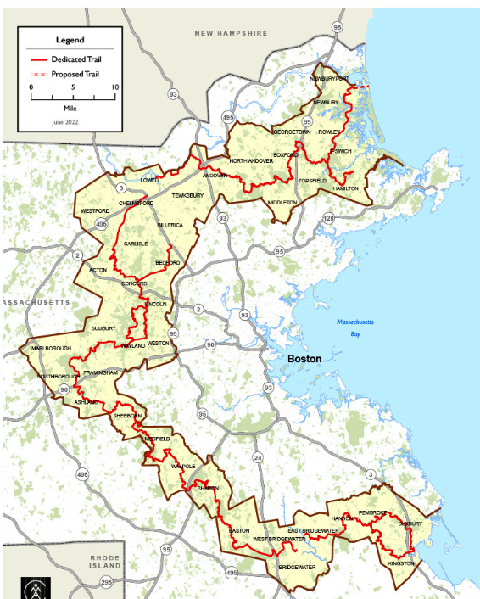
Bay Circuit Trail (BCT) Overview
Bay Circuit Trail
“The Bay Circuit Trail and Greenway or Bay Circuit is a Massachusetts rail trail and greenway connecting the outlying suburbs of Boston from Plum Island in Newburyport to Kingston Bay in Duxbury, a distance of 200 miles.”
Wikipedia
Merrimack River Bike Trail
BFRT
Narrow Gauge Rail Trail
Reformatory Rail Trail
In over 200 miles of trails assembled from trails in 37 towns linked together, there are some gaps left to complete the circuit.
Greater Lowell and Bridgewater are the notable gaps.
Note east & west branches north of Concord
https://www.baycircuit.org/

Slide 7
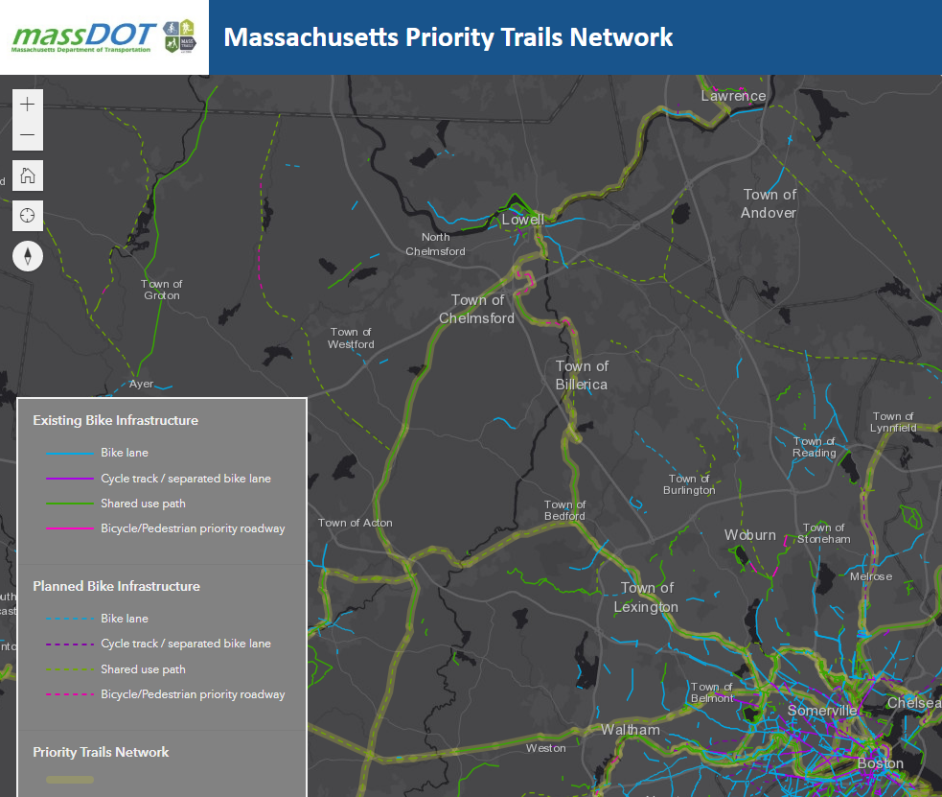
Merrimack River
Concord Greenway
Gap
Gap
Middlesex Canal
BFRT
Billerica Branch RR
Gap
Yankee Doodle
Gap
Narrow Gauge
Minuteman
Reformatory
Mass Central
BCT

Slide 8
First Project
“Thoreau Towpath” or “Riverneck Road”
5.7 miles connecting the open ends of
BCT West Branch = Bruce Freeman Rail Trail (BFRT) in Chelmsford
BCT East Branch = Yankee Doodle (YD) Rail Trail in Billerica
Using the historic canal towpath, old RR, woods, & streets

Slide 9
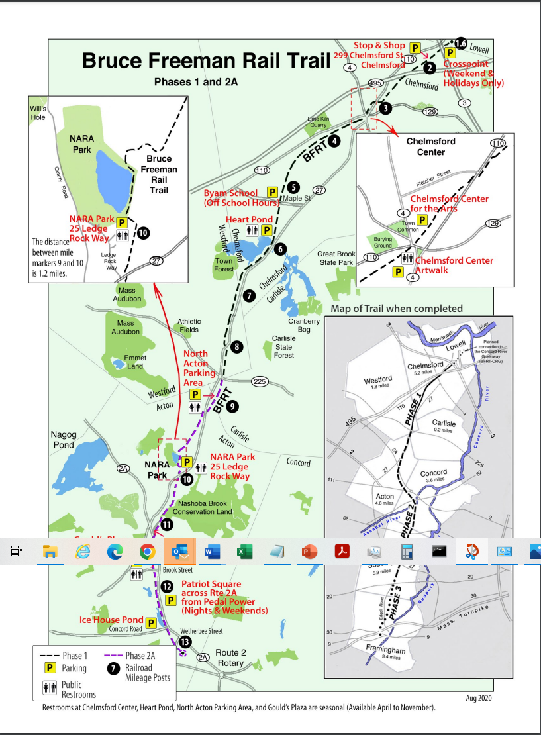
Bruce Freeman Rail Trail (BFRT)
Acton/Carlisle/Westford/Chelmsford section of the BCT west
Starts near Concord rotary
Perfect trail all the way:
good surface
guard rails wherever needed
crossing signs on small roads
automatic flashing signs on major roads
bridge over 2A in Acton
tunnels under 495 & 3 at Lowell
Formal BFRT ends just into Lowell at Cross Point (Wang) Tower
Extension in progress and passable up to behind Target just off the Connector
Gap getting to Concord River Greenway and thence BCT to Newburyport
Scale: See mile markers

Slide 10
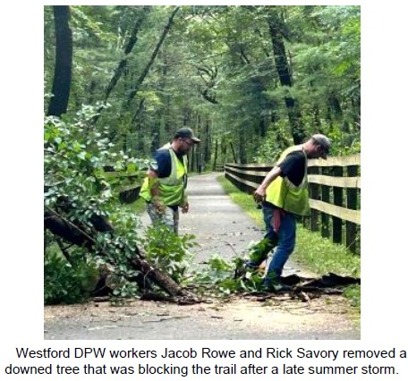
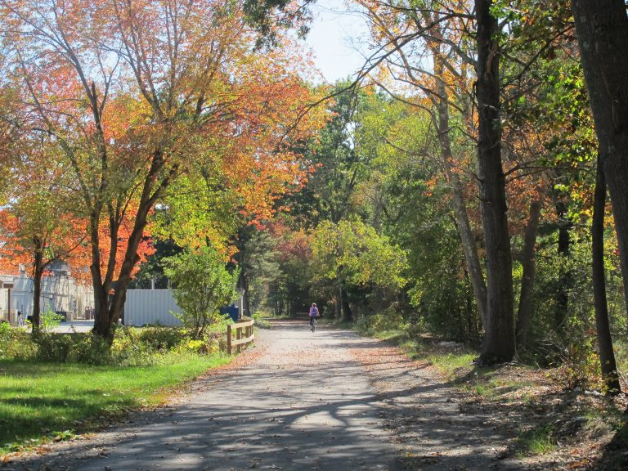
Bruce Freeman Rail Trail (BFRT)
Fall trail in Acton
Pix from https://brucefreemanrailtrail.org/

Slide 11
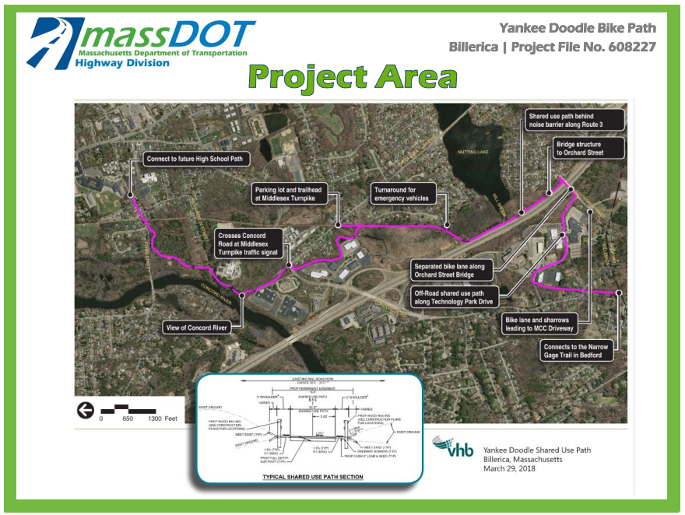
Yankee Doodle Trail - Billerica
Note trail on MassDOT right of way
Billerica
Route 3
“Billerica Branch” RR track and powerline from Summit Pond area
Bedford
NORTH
Bedford Narrow Gauge Rail Trail
Route 3
Note: North is left!
Route 3

Slide 12
South section: via “Billerica Branch” of old B&M RR Originally the Billerica & Bedford Narrow Gauge RR
On Roadway
Smallpox Cemetery
MBTA Station N Billerica
Dam
Woods Trail
Canal
On Canal Towpath
Old B&M RR junction
Iron Horse Park (old B&M shops)
3A
Concord River
On Billerica Branch Rail-with-Trail
Power lines continue to YD trail at High School
From “MBTA’s Billerica Branch”, Presentation to Billerica's Open Space and Recreation Plan Committee", 13Jan2023, Andrew Jennings

Slide 13
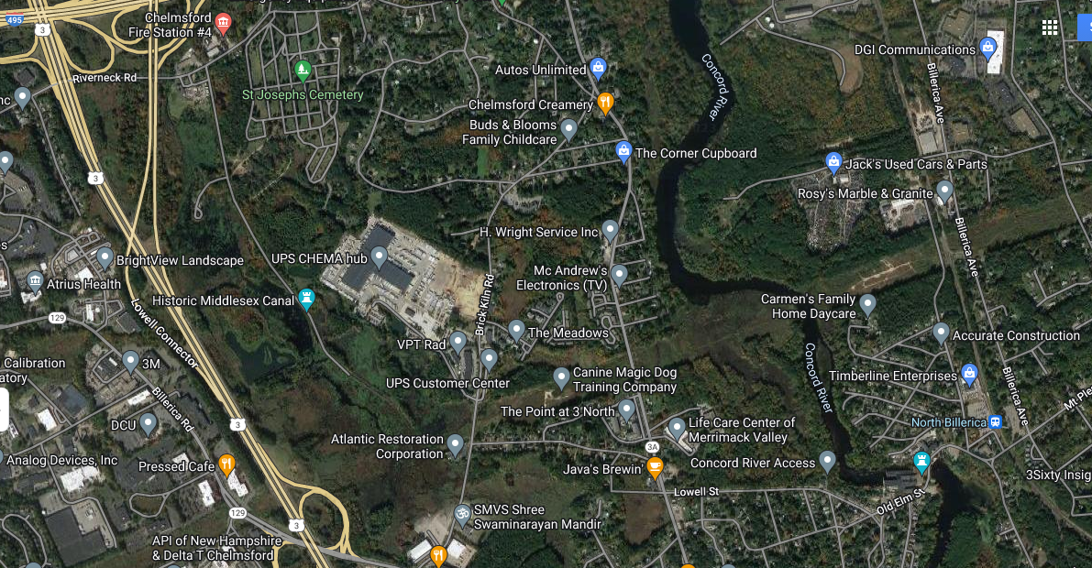
Towpath Section Summit Pond Dam to Canal Street
Canal St
Canal St (dirt)
Commuter rail
Route 3A
often swampy
often swampy
mill pond
Brick Kiln
well maintained
Old RR

Slide 14
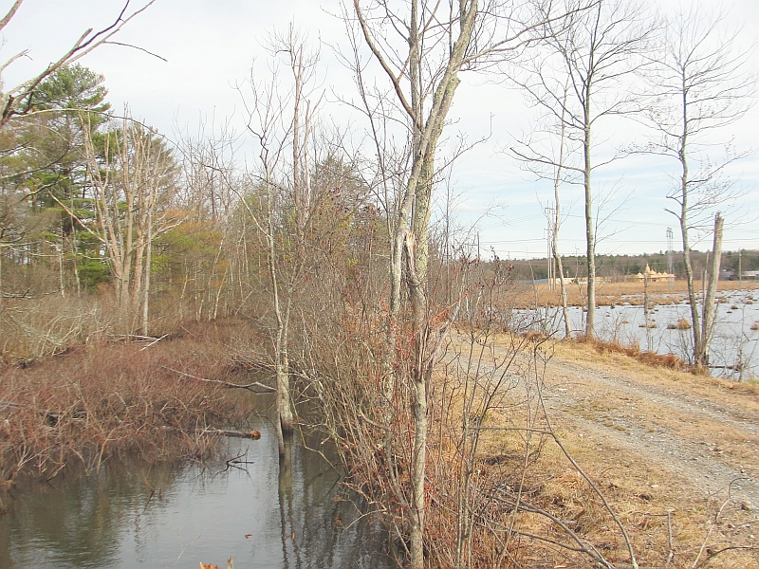
Typical Canal and Towpath Canal St, East Chelmsford
J Breen, from Towpath Topics front cover, April 2023

Slide 15
North Section: via Road and Woods Crosses Rt 3 on Riverneck Road
Original Idea
- Connect to BFRT south of tunnel
- Run along highway right of way, far below traffic, like Yankee Doodle beside Route 3
- Easement at east side of 191 property to Riverneck Road
- Riverneck Road over Rt 3 and under Lowell Connector, to Middlesex Canal via Canal St, thence Yankee Doodle to Bedford
Multi-use Trail
Bike Lane
BFRT to Lowell
Alternate Idea
- Avoid dealing with MA DOT by using town open space and Water District road
BFRT to Lowell
495 Highway Right of Way
Town Open Space
to Canal St
Common Factors
- Public land ¾ mile from BFRT to highway ramp 495 to 3
- Need to squeeze between ramp and buildings and cross private land for last couple hundred yards
Developer’s land
BFRT to Kingston
Riverneck Road

Slide 16
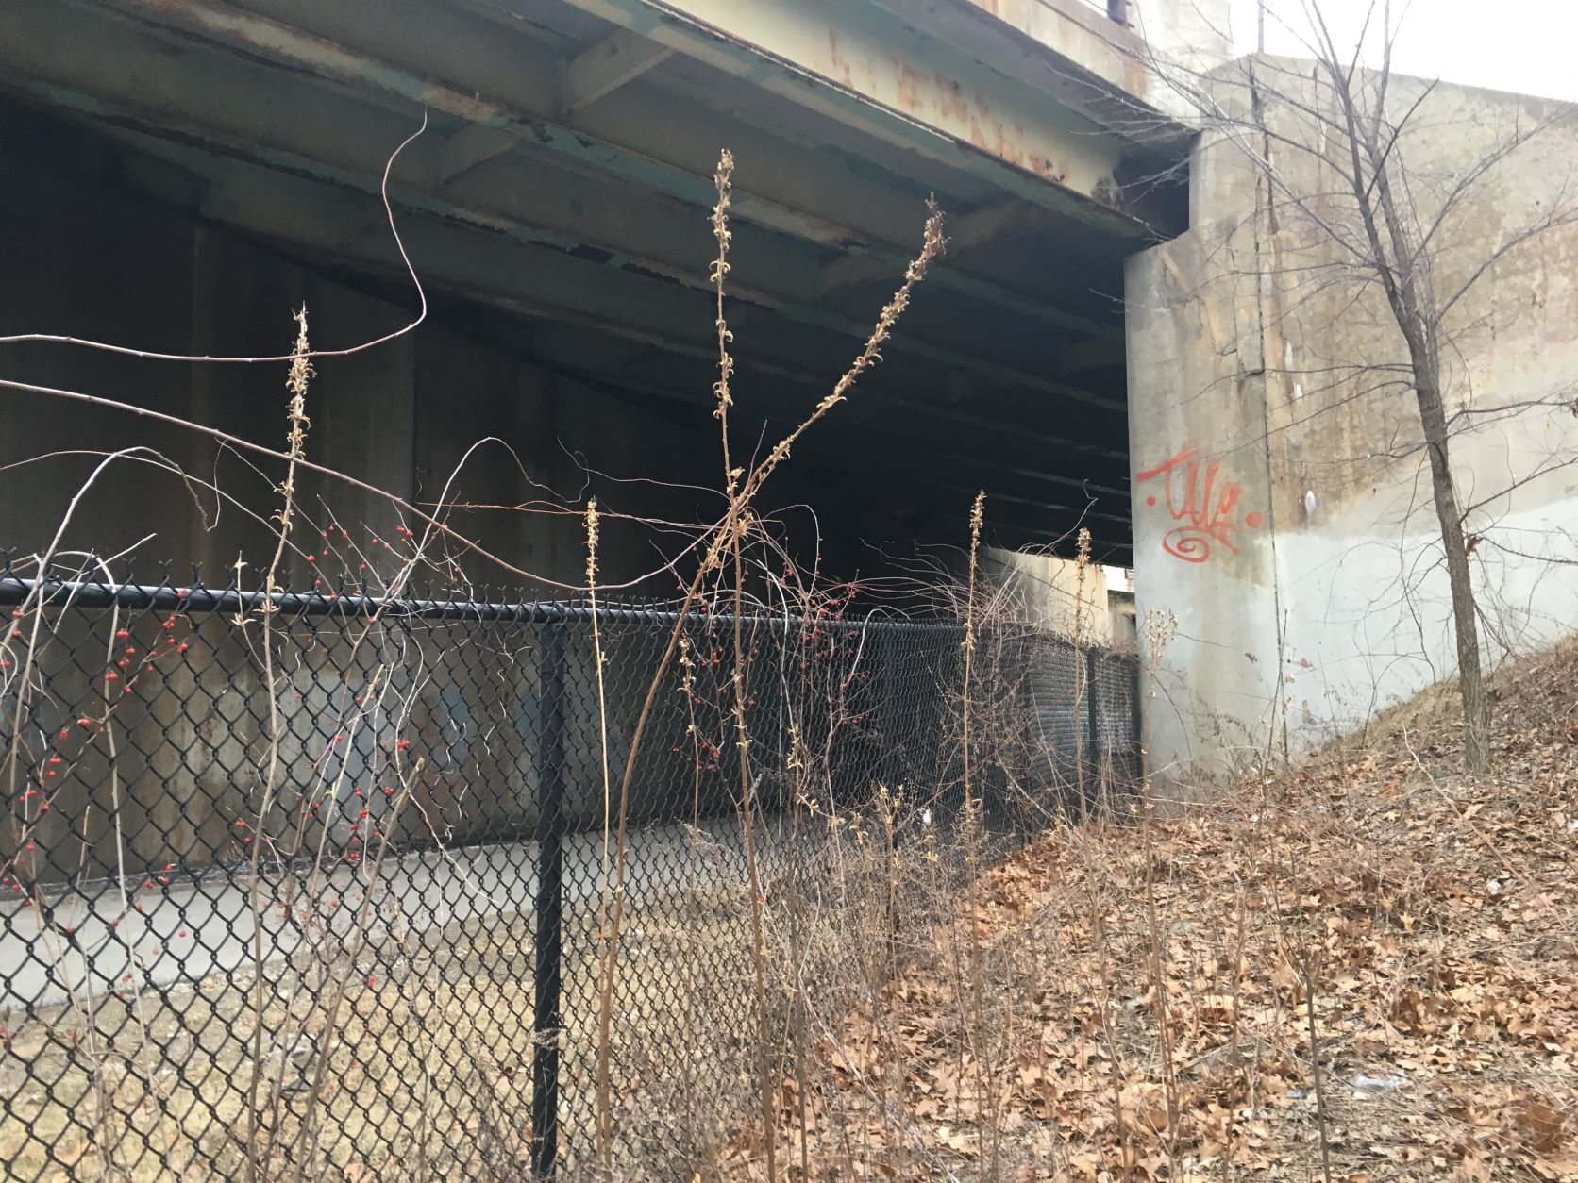
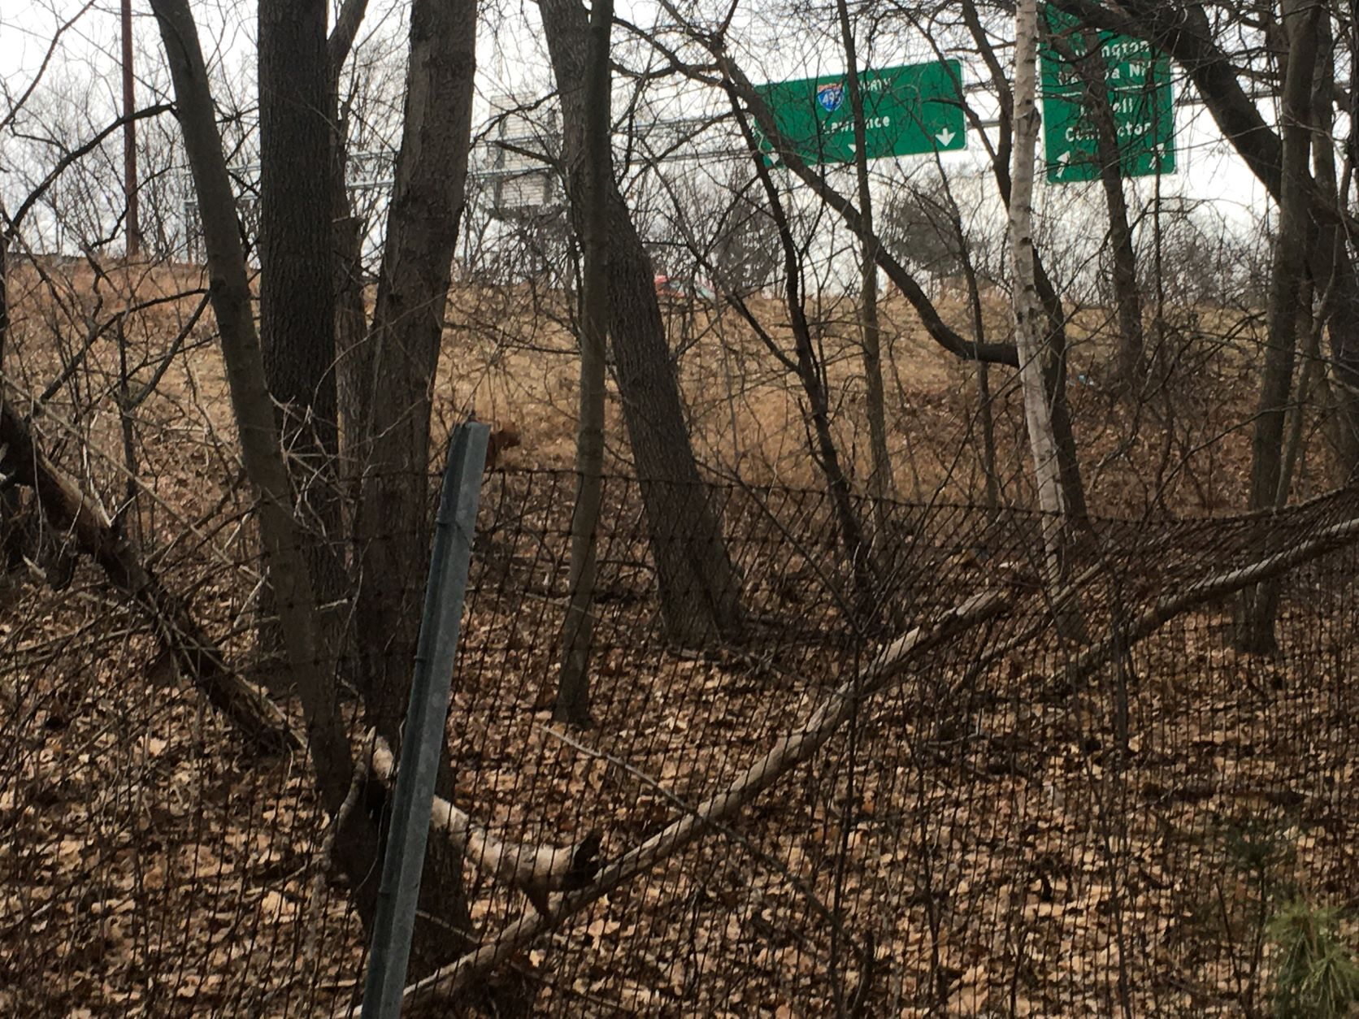
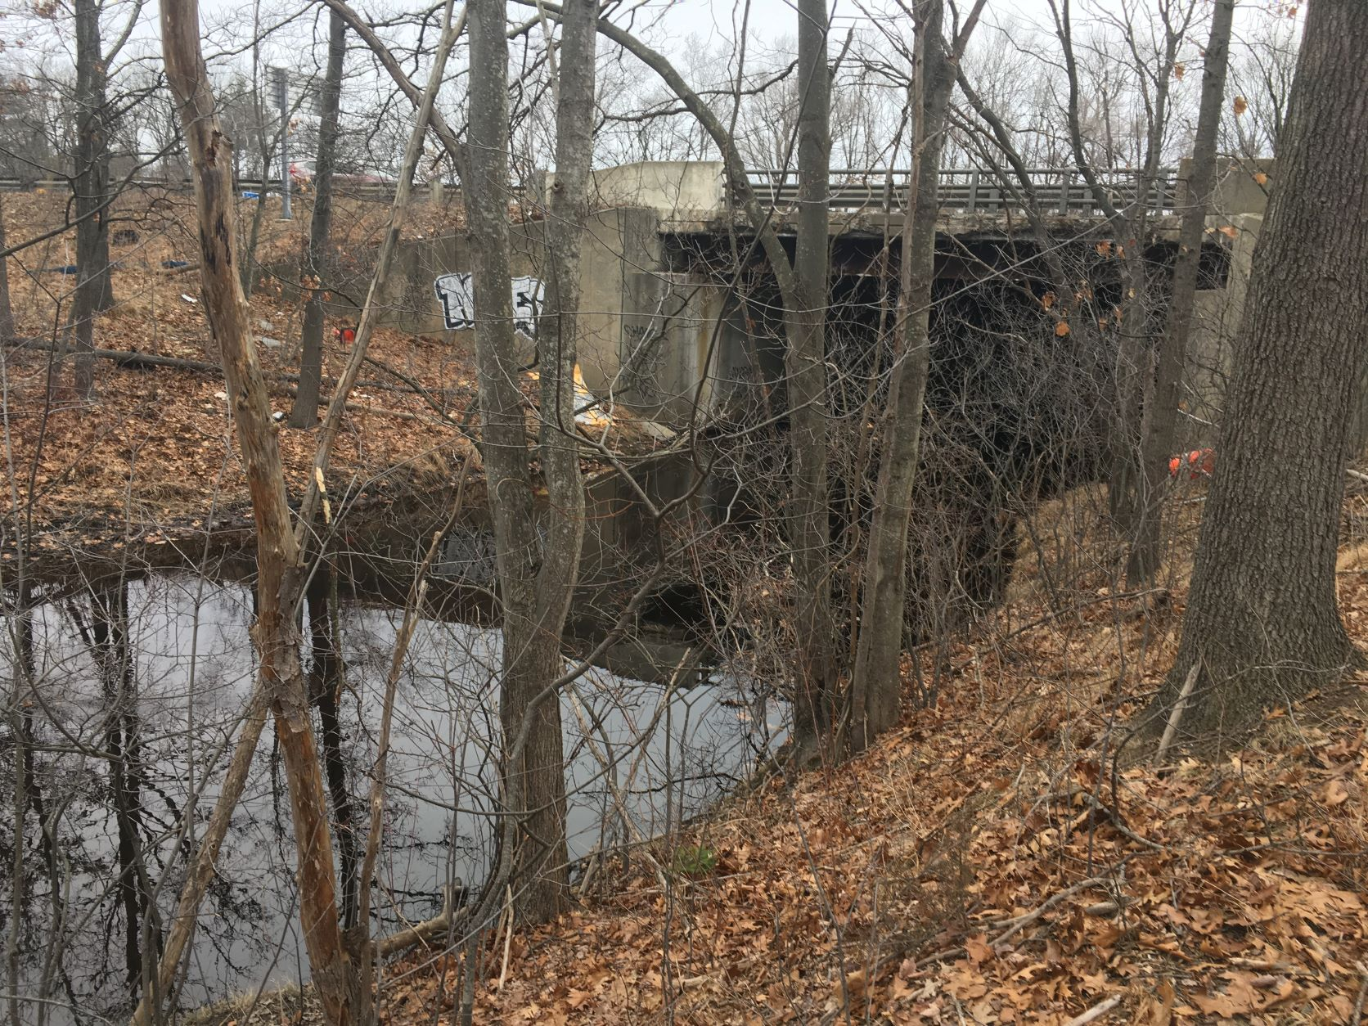
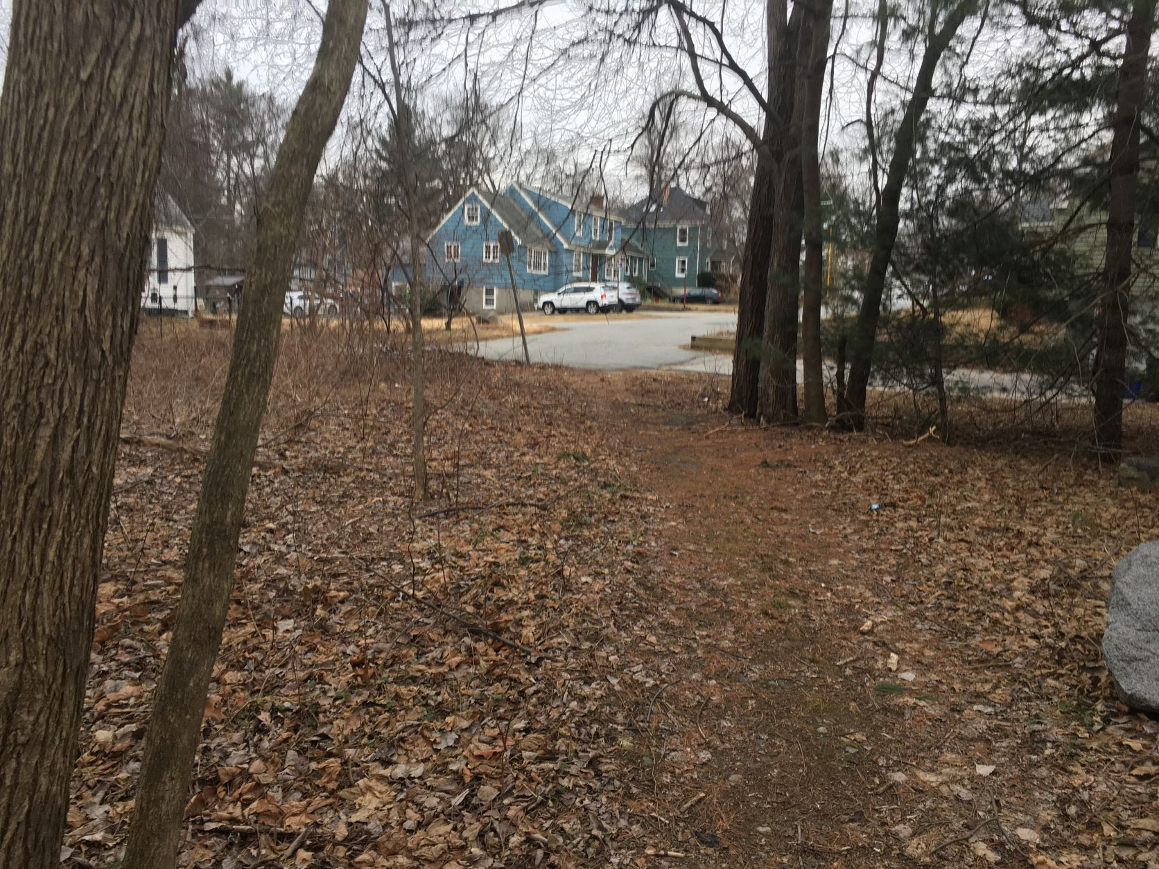
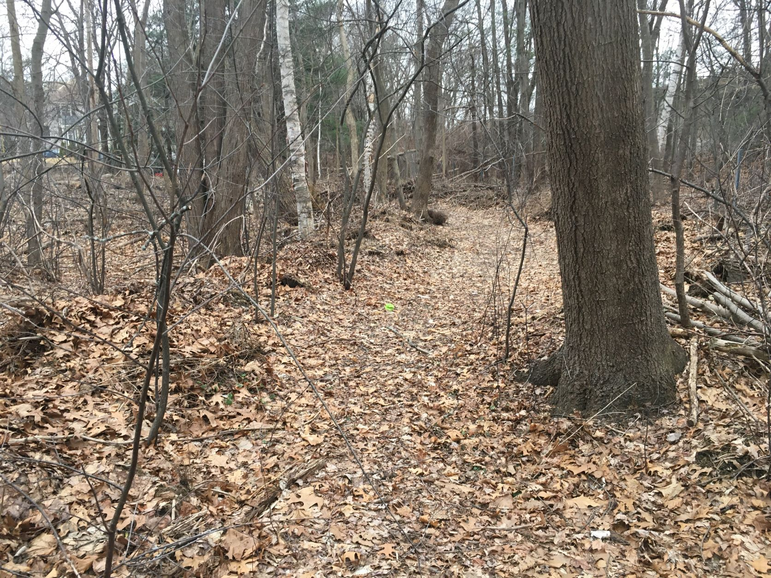
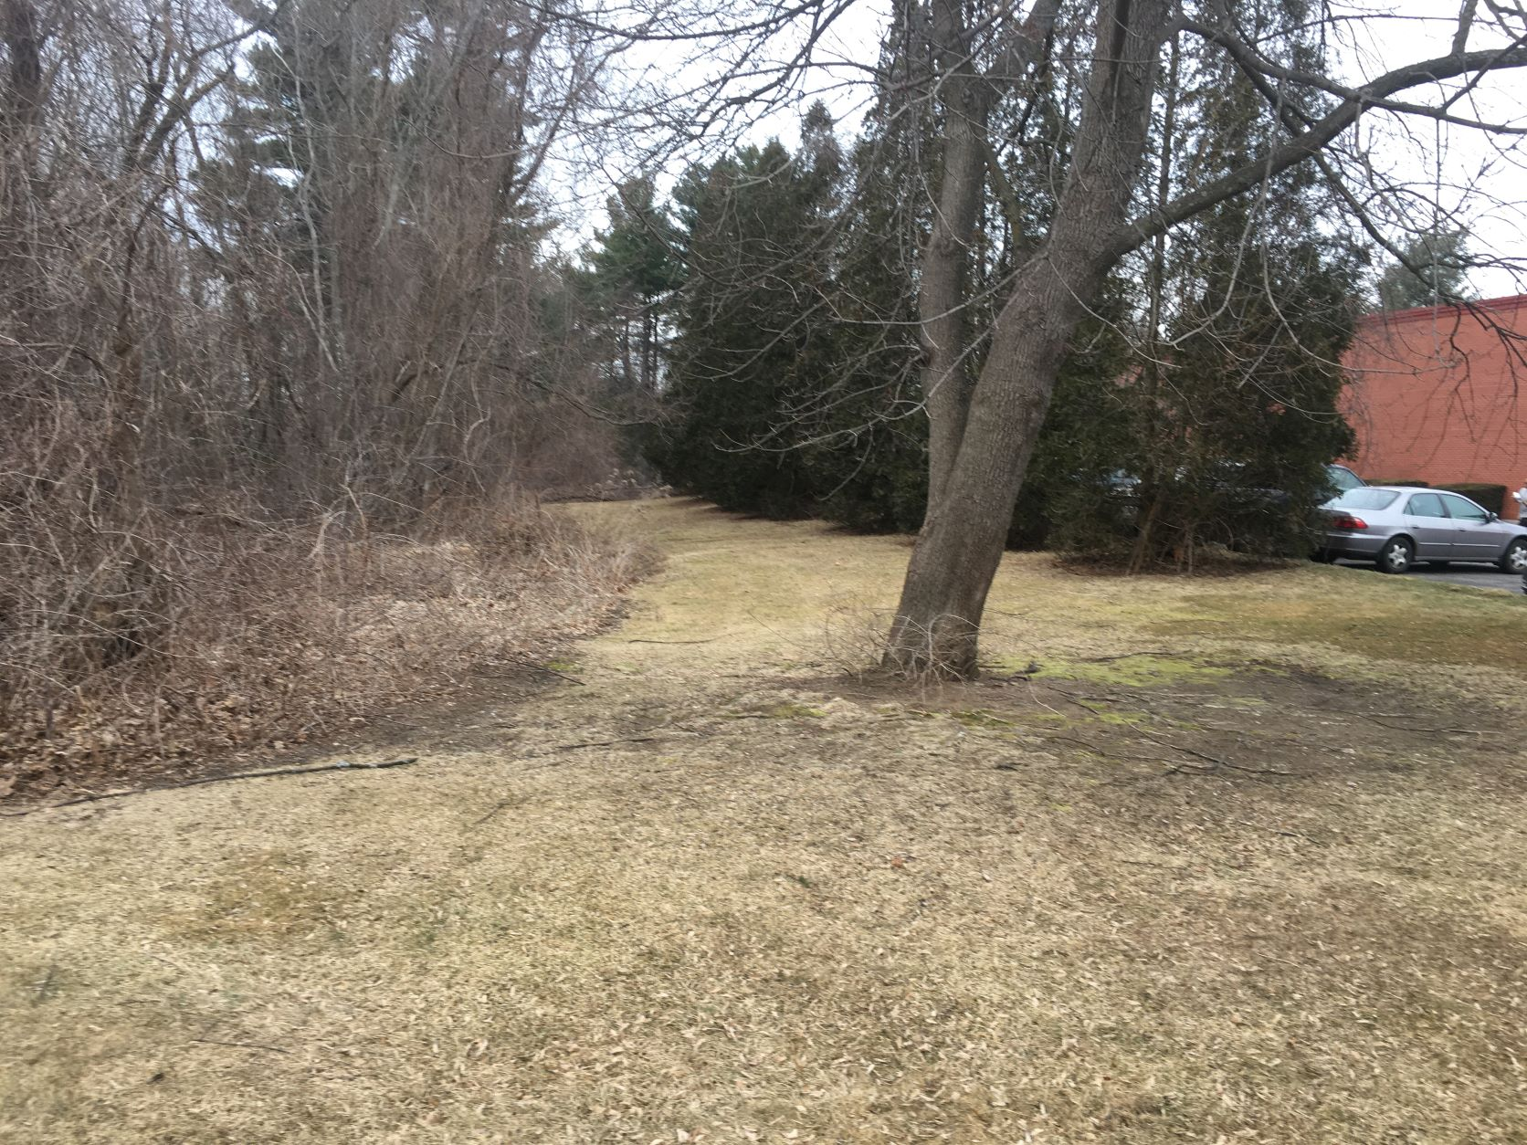
BFRT to Riverneck Road - Photos
BFRT Tunnel from 495E Right of Way to NW
Off-Highway Right of Way to NE
River Meadow Brook, Bridge Needed to NW
Trail off End of New Fletcher St to W
Trail on Town Open Space to E
Possible Easement at Riverneck Road to N

Slide 17
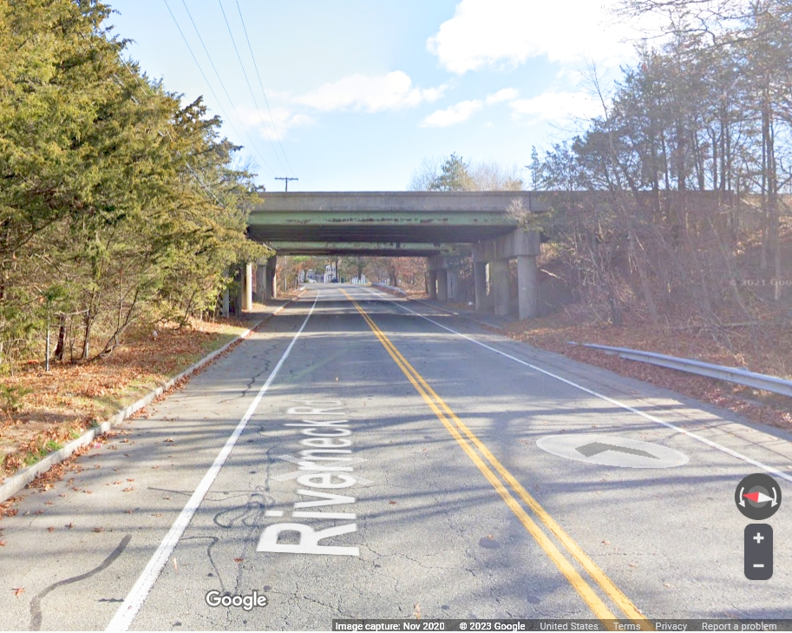
Wide Enough for a Legal Bike Path

Slide 18
Before you say it ….
Of course this is a long term plan - maybe another decade with work by many groups:
Easement/permission from MA DOT below 495 won’t be trivial
nor for town open space “protected wetland”
River Meadow Brook needs a real bridge, not culvert
Riverneck Road needs painting & maybe widening for bike lane
Town Engineer says it is wide enough to do this
Water Districts may want to protect well field south of Canal St, but
Canal St seems to be a town road and multi-use trail (per MassDOT)
Middlesex Canal Association has two easements already from owners
Canal towpath between Canal St and 3A is seasonal, very boggy
About a half mile needs a boardwalk (or tons of fill)
Bridge by the Concord dam is dangerous for cars, much less bikers
Connection from dam to Billerica Branch RR needs easement
Billerica Branch RR track and power line south to Billerica High is good for trail, but still MBTA owned
However, decades of patient work in steps is how we got BFRT, BCT, Yankee Doodle, Middlesex Canal Museum, etc

Slide 19
Second Project
Lowell Middlesex Canal Heritage Park and Trail
Also a “Thoreau Towpath”
2.7 miles connecting the ends of
BCT West Branch = Bruce Freeman Rail Trail (BFRT) in Lowell
Esplanade Trail at Rourke Bridge, thence Merrimack River Trail and other BCTs to Newburyport
Using the old canal towpath, old RR, woods, and streets

Slide 20
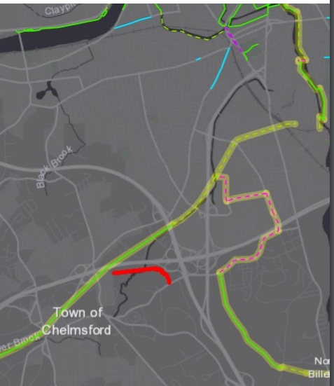
Area Trails and Plans – North End
Merrimack River Bike Trail to Lawrence & Newburyport, with bike lane in new 110 project
New Rourke Bridge with Bike Path
To BCT to Newburyport
Concord River Greenway
Canal N end
New Trail Bridge
Railroad-yard gap
Hadley Field
110
Pete Sutton & Lowell idea
MassDOT Plan ~ 1 mile of city streets + crossing active rail yard
Golf Course
3
Old MassDOT Plan ~ 1 mile of city streets + 1 mile of busy country road
110
Old Canal Bed
495
495
Canal St
Middlesex Canal
Trails Legend Existing
In progress
Proposed
Background
BFRT
3
Riverneck Idea
~ 1 mile of woods trail
+ ½ mile of bike lane
To Yankee Doodle Trail

Slide 21
Continuation of BFRT and Canal Towpath Trail Through Lowell to Merrimack River
Rourke Bridge project
Hadley Field
(Park)
Old Dump (“Mount Trashmore”)
Stedman St
Route 3
Connector
Swamps, not lakes
110

Slide 22
Origin, Terrain, and Funding
Some members of the Middlesex Canal Commission and Association are helping to plan a park, nature trail, and multi-use path to commemorate the Middlesex Canal section in Lowell
Terrain
Merrimack end of the old canal is obliterated by development
South of that, canal remains as a water hazard on the golf course
South of golf course is a quarter mile of the best preserved canal in 27 miles, with water and towpath intact
In the middle, the canal is now under swamps and Route 3
To east, there are two Lowell schools that would benefit from nature trail and shortcuts for neighborhood kids
South of the swamp is excellent ROW for a multi-use path to 110
Just across 110 is the Cross Point end of BFRT
Funding would be from federal and state grants
Following discussion proceeds S to N, easy to hard

Slide 23
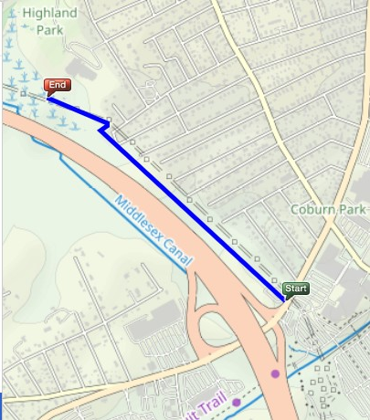
Easy Trail: Via Pipeline & Powerline, BFRT/110 to Schools = 0.7 miles
Starts just across the Cross Point parking lot from east end of BFRT (old Middlesex Canal route)
Pipeline (west route):
OK as is for walking/running or mountain bike
Six 1-2 foot stream jumps
Enter from Alpine Butcher
Powerline (east route):
Flat and level but overgrown
Enter behind brick pump house Paths overlap in some places
Either one is almost as good as a railroad right of way to build on
Choice depends on easements and safety rules
All land owned by City or Electric Co
Schools
Stevens St
3
110
Powerline
Pipeline
110
3
BFRT

Slide 24
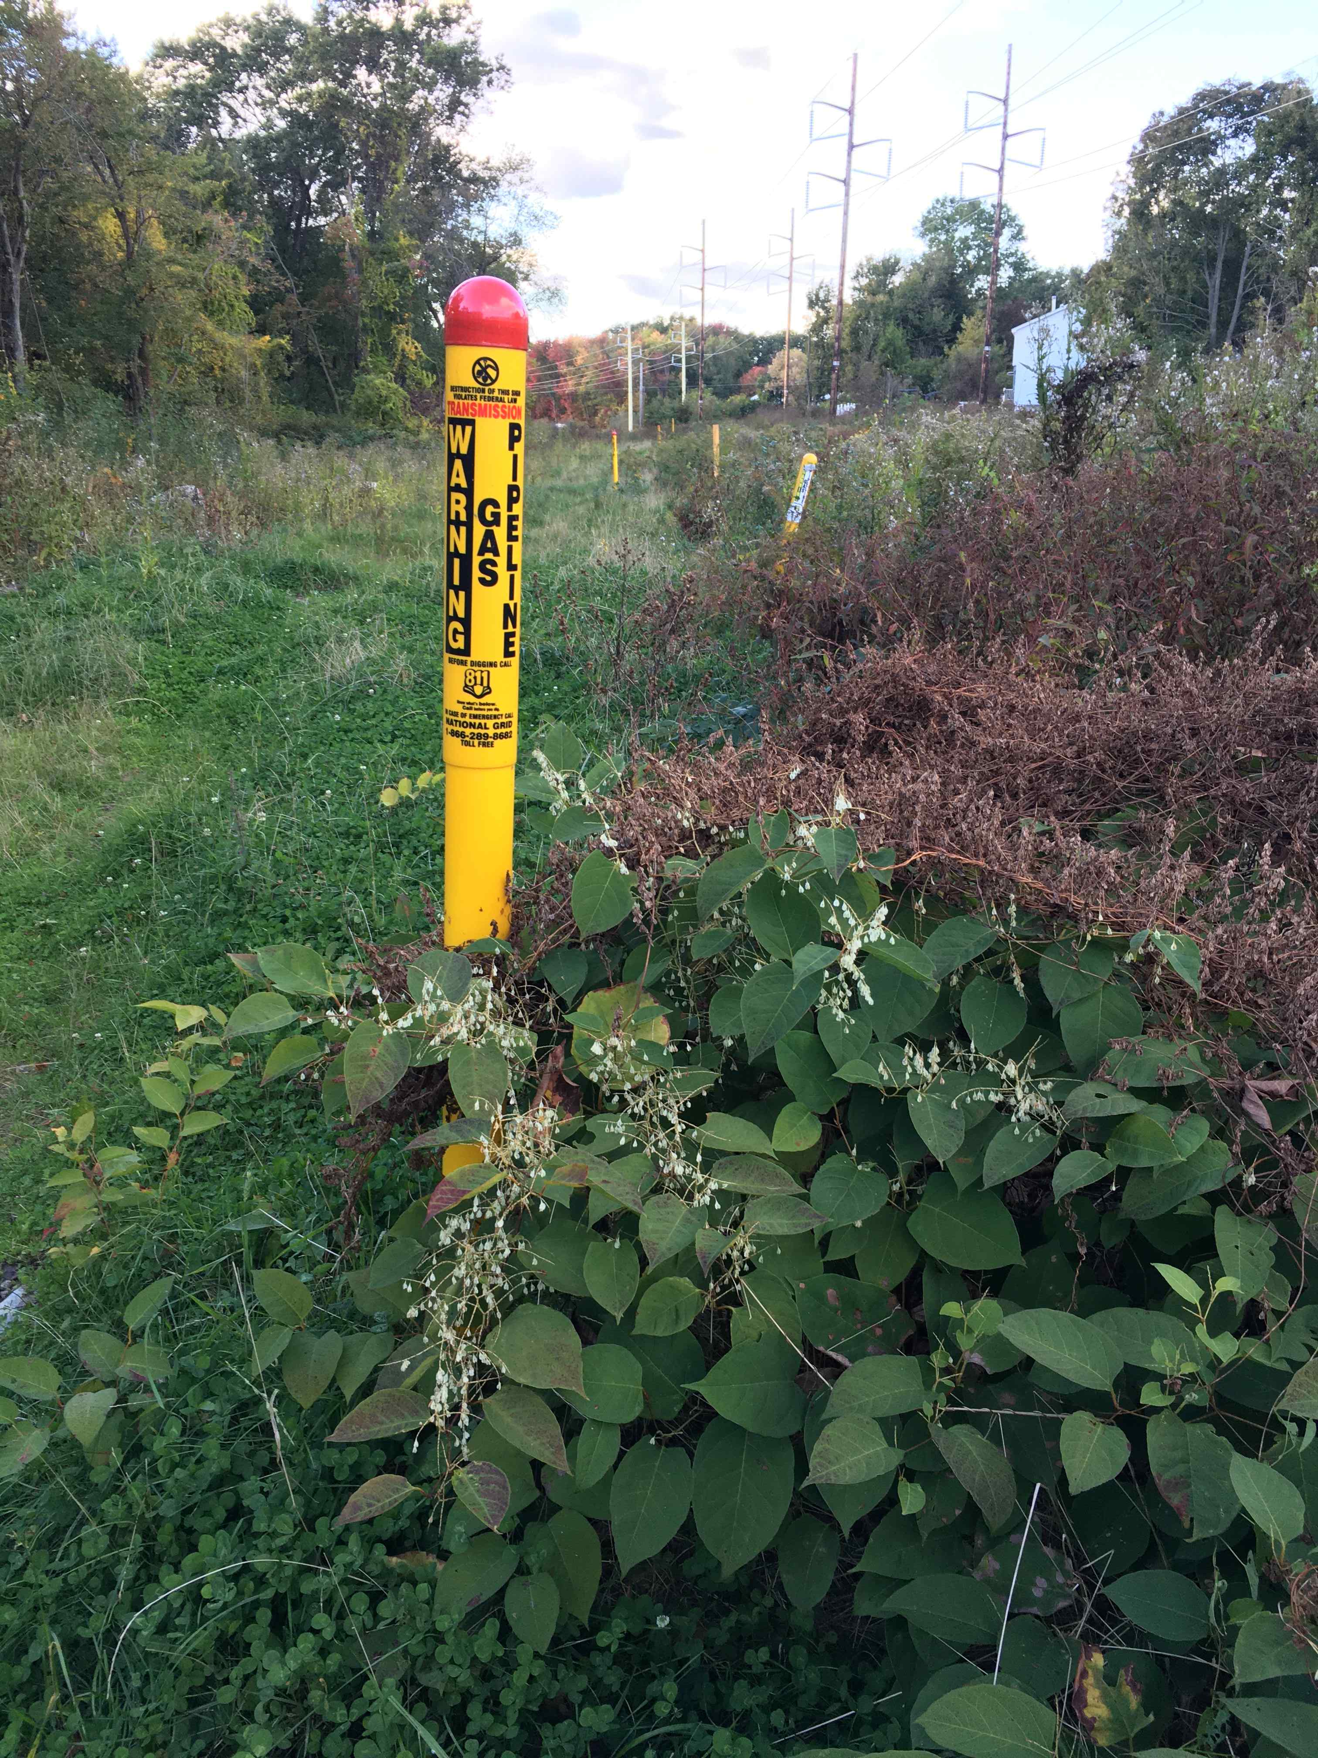
Pipeline & Powerline Route
Looking North from MA Route 110 at Cross Point Towers

Slide 25
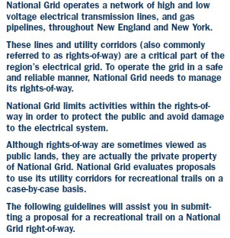
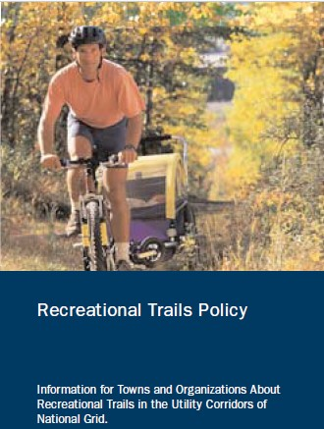
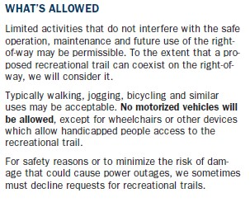
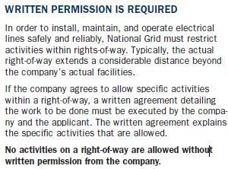
Nat Grid Trail Policy
Extracts from National Grid Tri-fold pamphlet

Slide 26
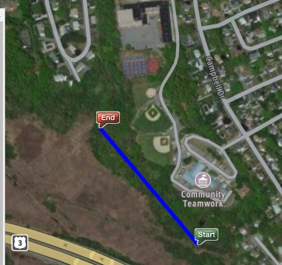
Easy Park and Nature Trail: Swamp to Schools = 0.3 miles
Flat woods:
- Above the waterline
- Downhill from schools and ball fields
- About 1000x200 feet (5 acres) of flat land
- Good for nature trail, park, picnic tables, etc
- Well-worn easy paths already --“Start” to Bailey School --“End” to ball fields
All land in this segment is owned by the City of Lowell
Daley
School
Bailey School
½ mi

Slide 27
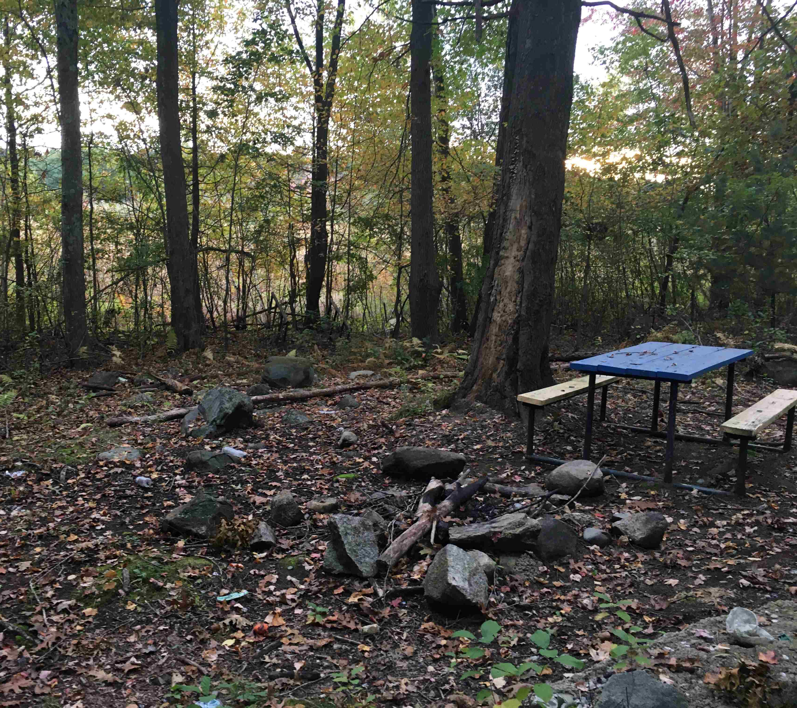
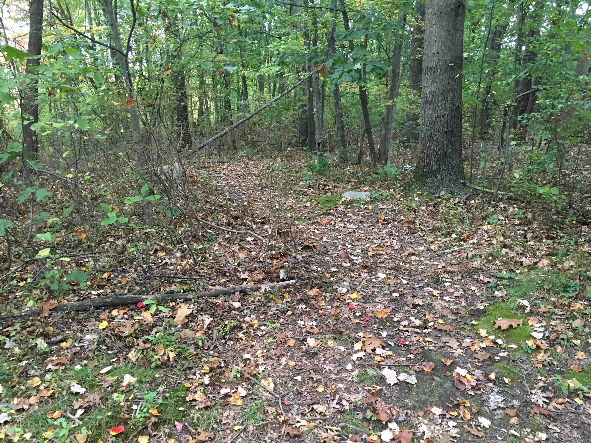
Park & Nature Trail
Five acres of flat land down hill from the schools

Slide 28
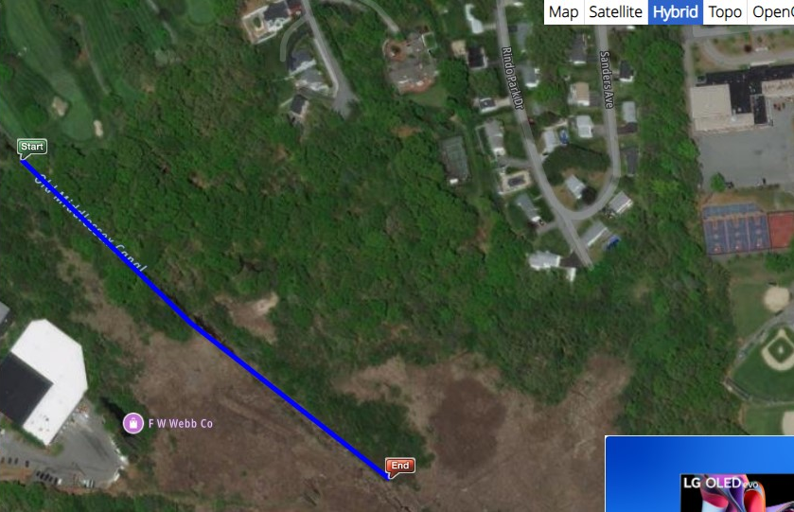
Hard Trail: Schools to Local Streets or Canal = 0.3 miles
Westview
Rindo Park
Sanders
East side - Hard to find a good route that is:
- Above the waterline
- Flat, smooth, and gentle enough for bike path
West side – 3 possible not perfect routes:
- #1 to Westview
- #2 to canal
- #3 side trip to canal
Land owned by:
- City
- Eastern Salt Co
- a few private owners
Golf Course
#1
Wet
Daley School
Flat, dry, open
Dirt Road
Good Towpath
#2
Steep
Wet
Flat, dry, open
Wet
OK
Wet
#3
Open swamp
Open swamp
½ mi

Slide 29
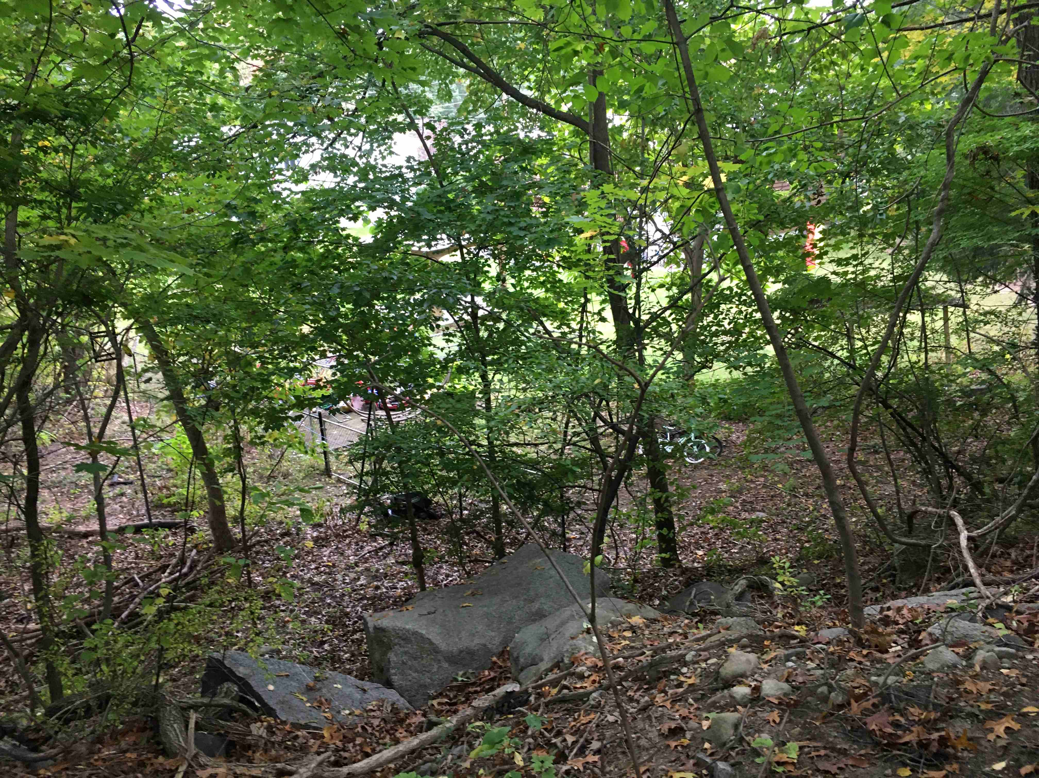
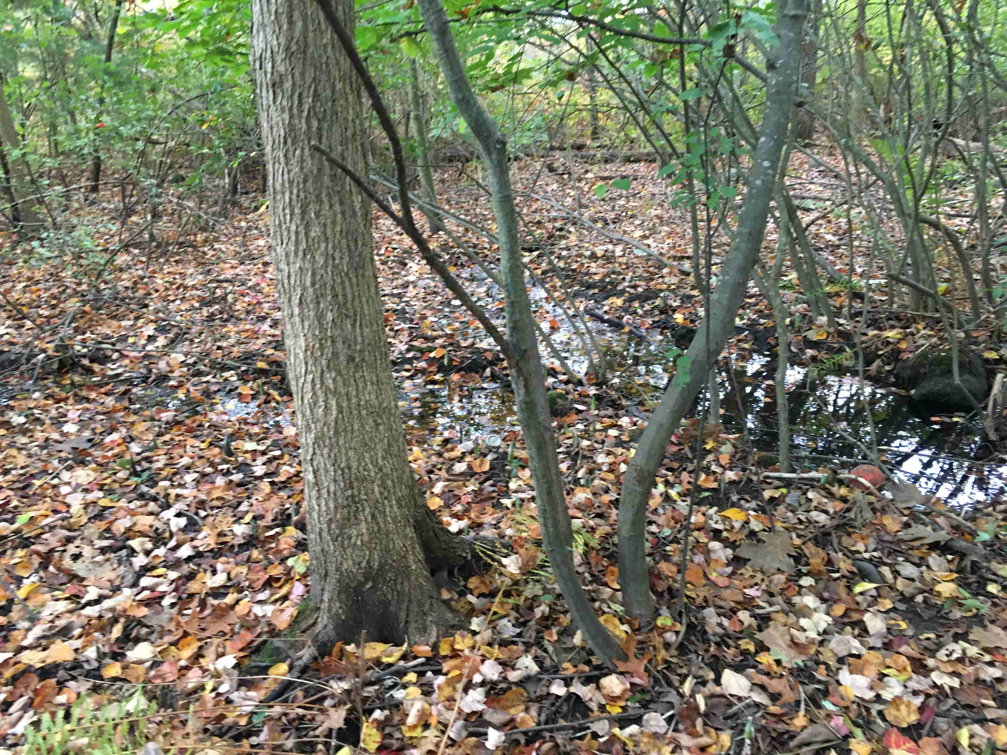
Schools to Golf Course
Typical Steep and Rocky
Typical Wet Areas

Slide 30
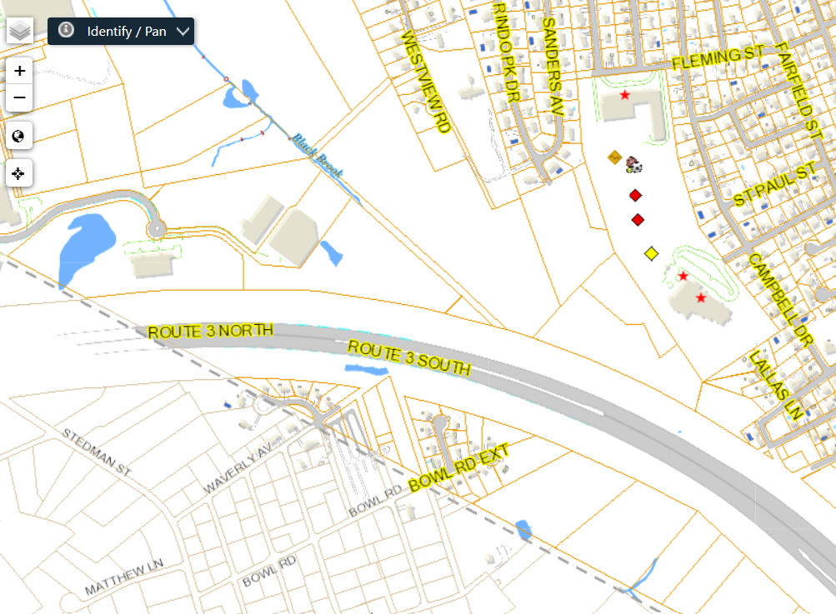
Land Ownership: Lowell Assessor “GIS” Map
Priv
GC
GC
Priv
GC
GC
Salt
Priv
GC
GC
None
Priv
McN
GC
GC
Priv
GC
Priv
City
City
Priv
E Salt Co
McN
City
Webb
City
Webb
City
Priv
Webb
None
E Salt Co
City
Chelmsford
None = MA DOT
Priv
City
City
Priv
None = MA DOT
City
Priv
Legend
City = Lowell
GC = Golf Course
Elec = one the electric companies
Priv = Private owner
Salt = Eastern Salt Co
https://www.easternsalt.com/
(McN = McNamee family, owners of Eastern Salt)
Webb = FW Webb Co
None = No data; means public land like city street or state highway
Elec
Elec
City
Elec
Priv
Chelmsford
½ mi
https://gpv.lowellma.gov/public/Viewer.aspx

Slide 31
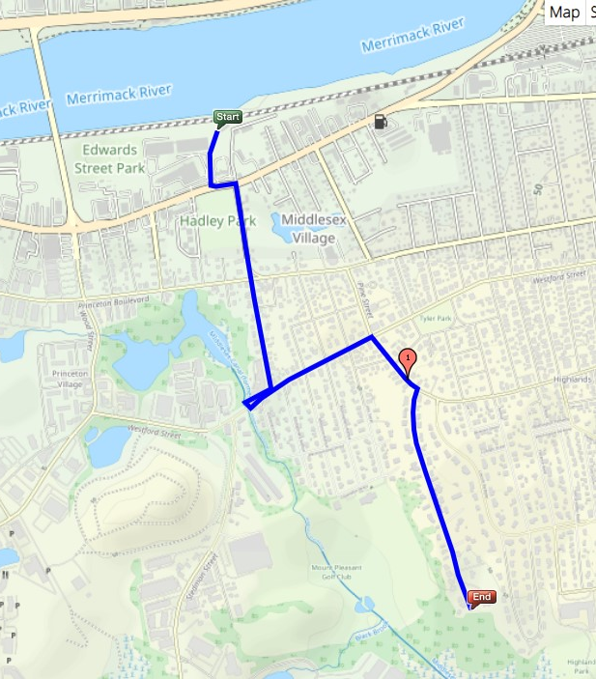
Northern End Options – Schools to Bridge ~1.7 miles
Rourke Bridge
Project with bike lanes
River trail to Lawrence&Newburyport
X
X
Not as easy as other sections
- At least 4 options, none of them perfect
- Mostly residential streets
- Solid blue is most likely route
Westford Street
Westview Road
Two “paper streets”
Swampy and would need easement from Eastern Salt
X
Canal route now buried
Baldwin St
Canal visible
Old Dump
Canal visible on golf course
G C
Daley School baseball field
¼ mile of beautiful canal
Scale: See mile marker

Slide 32
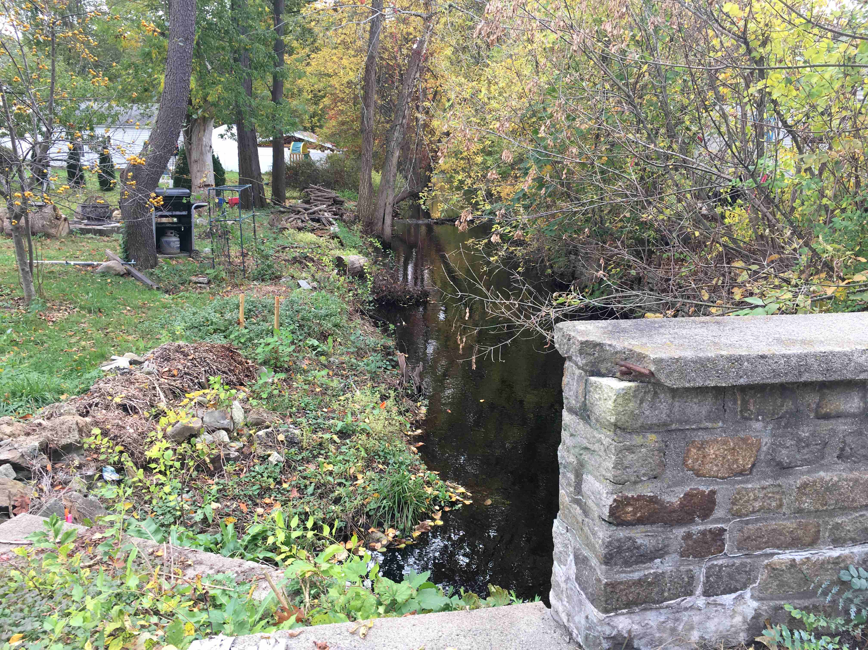
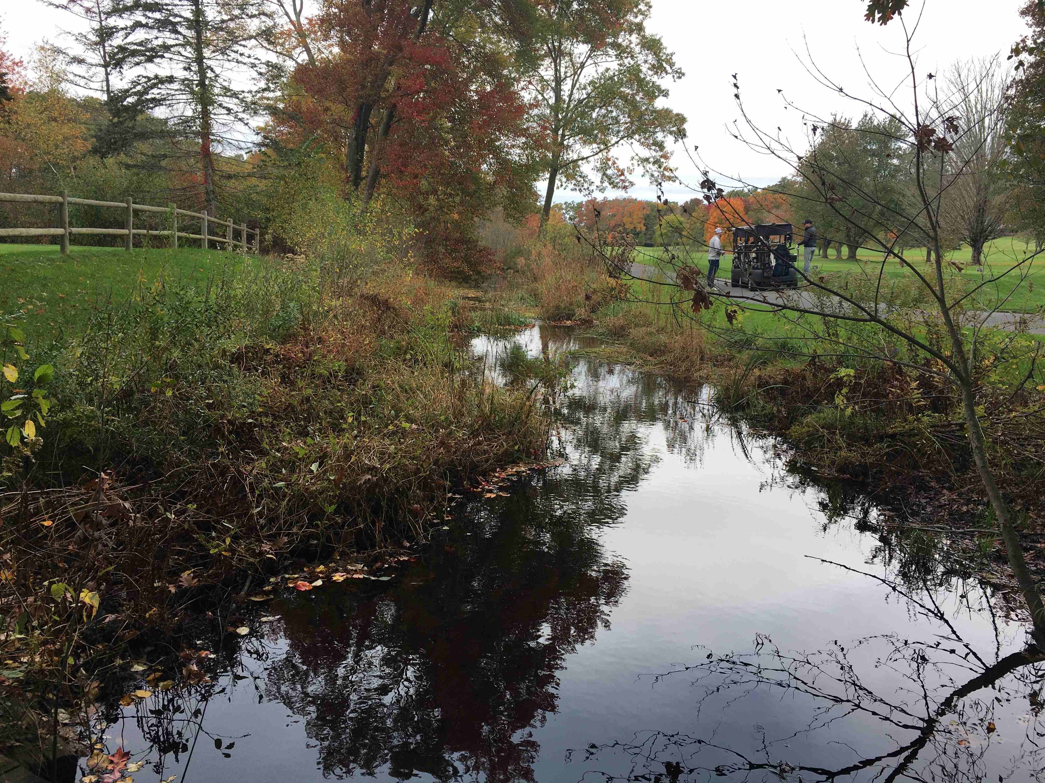
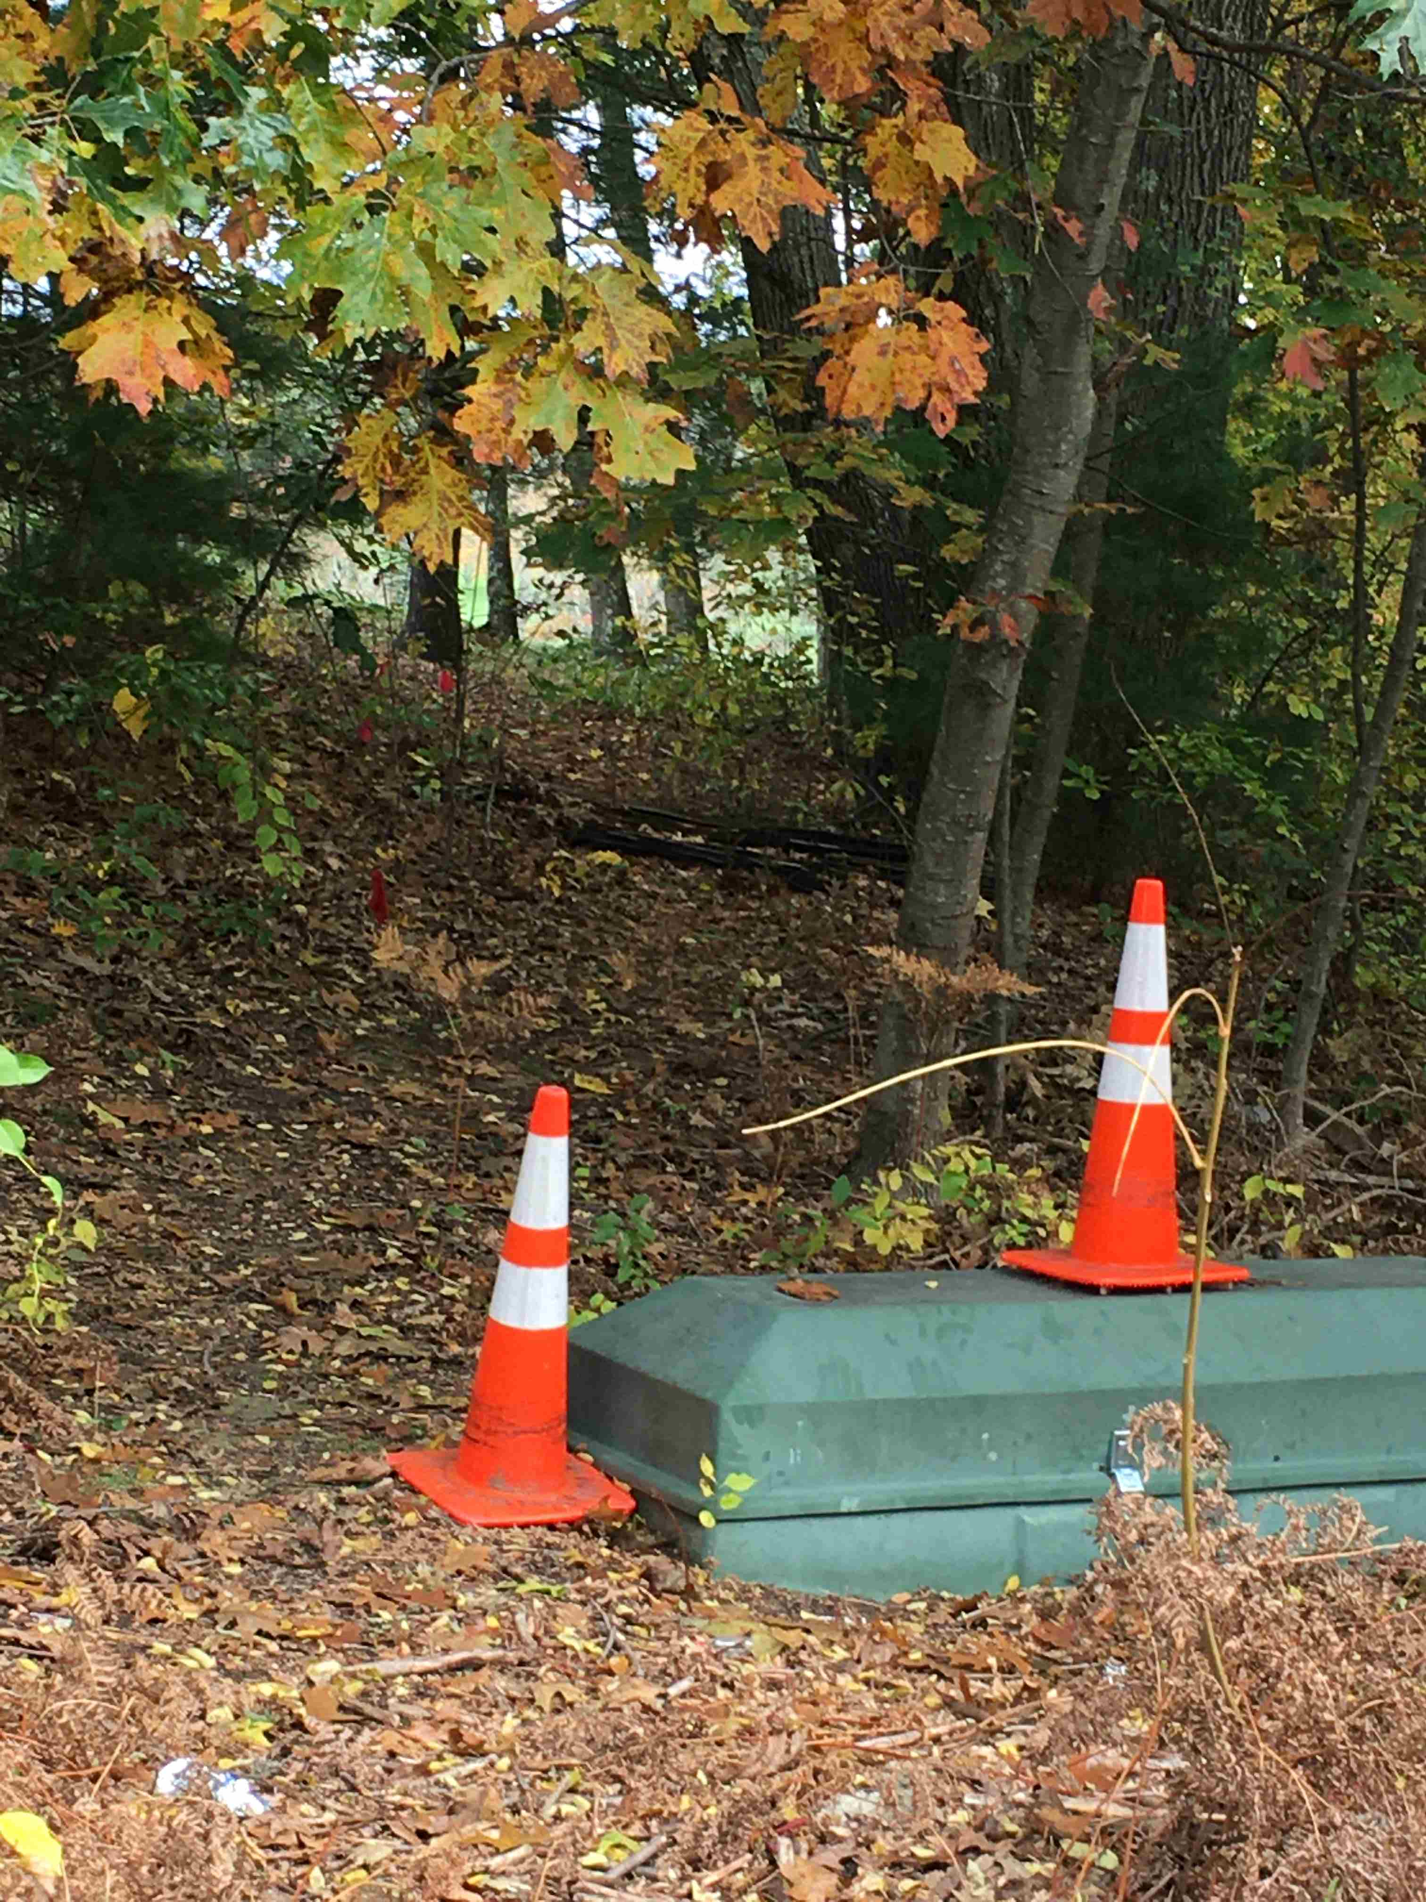
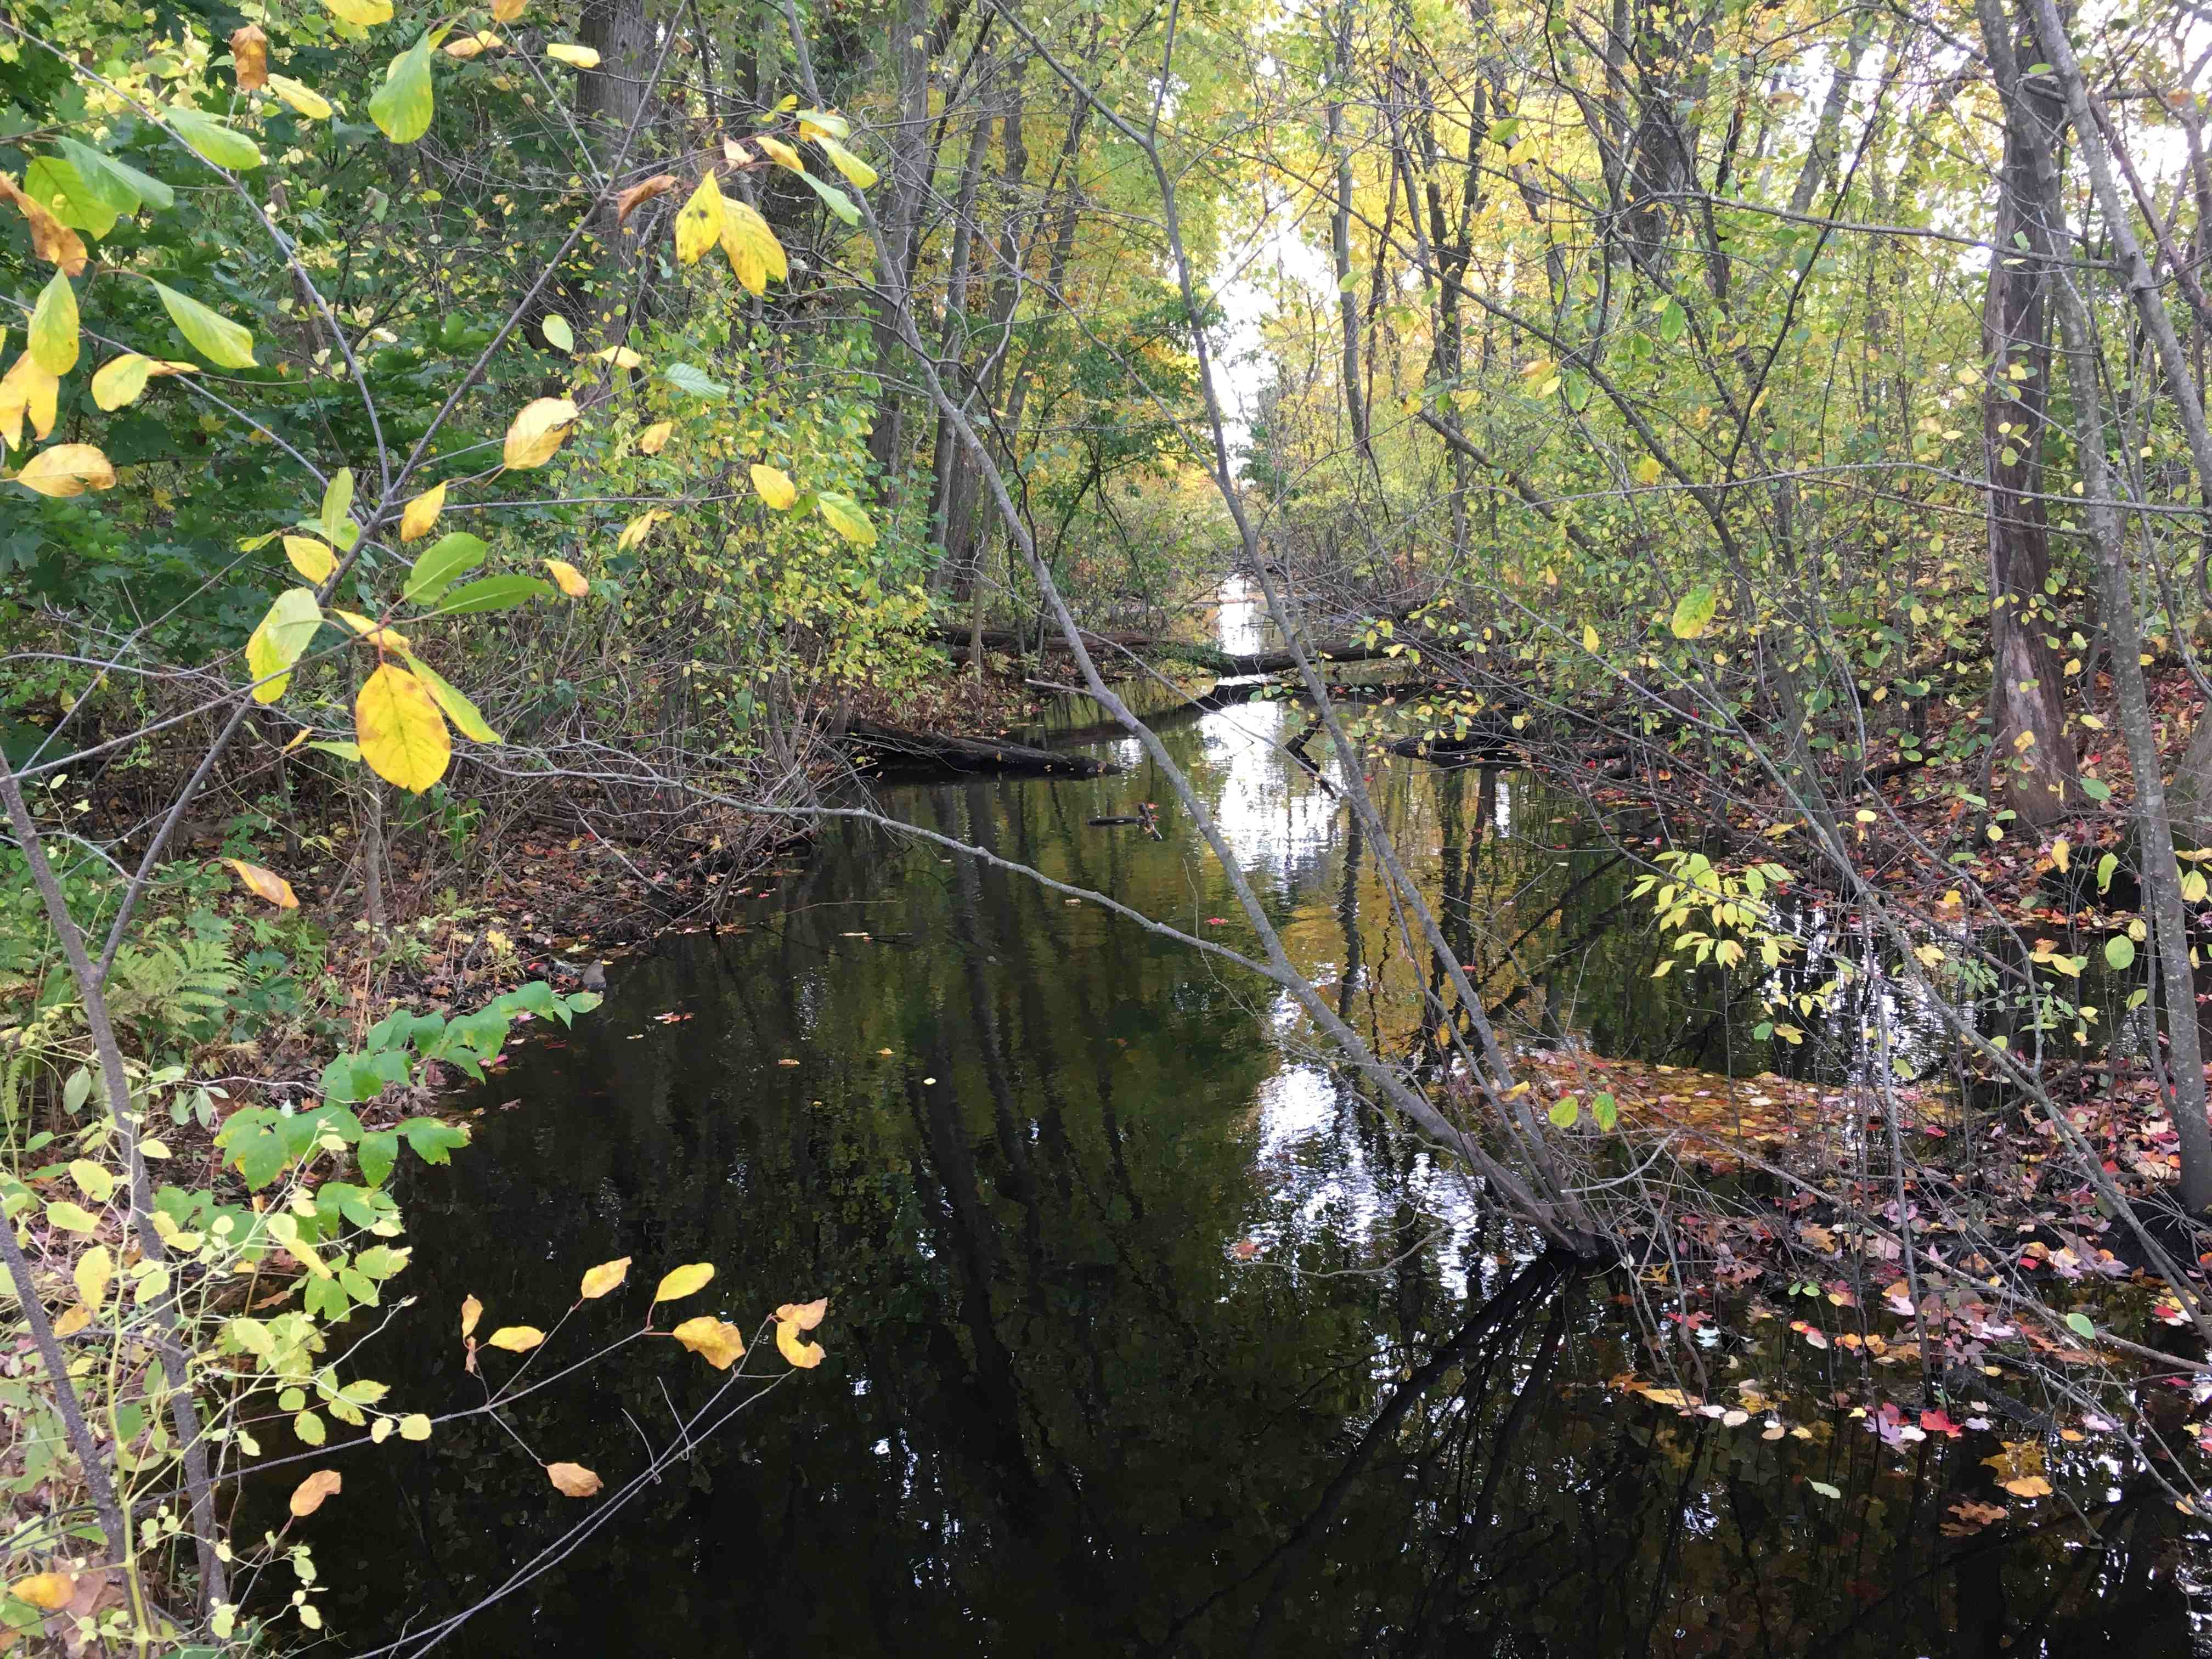
Original Canal with Towpath near Golf Course
Towpath Side
Canal South from Westford St
Canal North on Golf Course
“Paper street” to Golf Course
Canal South of Golf Course

Slide 33
Historic Link to Thoreau
In 1839 Henry David Thoreau took a trip in a small dory from Concord MA to the Merrimac River and wrote a book * about his travels.
An ardent naturalist, he preferred the natural Concord River over the new canal, but he noted:
"in the lapse of ages, Nature will recover . . . and gradually plant fit shrubs and flowers along its borders. Already the kingfisher sat upon a pine over the water, and the bream and pickerel swam below. Thus all works pass directly out of the hands of the architect into the hands of Nature, to be perfected."
One of the best sections of the canal on which Thoreau journeyed in 1839 still exists in Lowell, mellowed back to nature by the passage of two centuries of benign neglect.
Lowell's proposed MC Heritage Park will memorialize this inspiring author, his trip, and the low cost water transport that made Lowell competitive with Manchester England.
* “A Week on the Concord and Merrimack Rivers”, 1839

Slide 34
Summary
This project is just early concept work
Trail from BFRT to schools looks relatively easy
Includes safe routes to school, a park, and a nature trail
Harder from schools to city streets or canal
Some engineering needed for wet and steep parts
Three options for northern end
Two include a quarter mile of original canal
Most land is owned by city or the electric companies
A few privately owned parcels may need easement
Canal routes need an easement from Eastern Salt Co.
Encouraging news: This is a family owned company with national HQ on Middle St in downtown Lowell
More work to be done

Slide 35
Third Project
BFRT Lowell Extension
2.7 miles connecting
North end of the BFRT at Cross Point
Concord River Greenway, thence Merrimack River Trail and BCTs to Newburyport
Via old RR, quiet streets, and city park

Slide 36
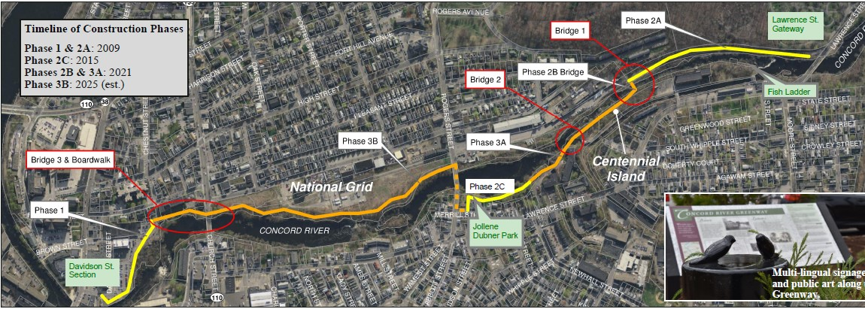
Concord River Greenway
← North
~1.5 mi
South →
Extract from pamphlet by:

Slide 37
LP&RCT BFRT Connection Concept
Greenway
Greenway
Old RR
Target
Cross Point
Extract from pamphlet by:
<-BFRT

Slide 38
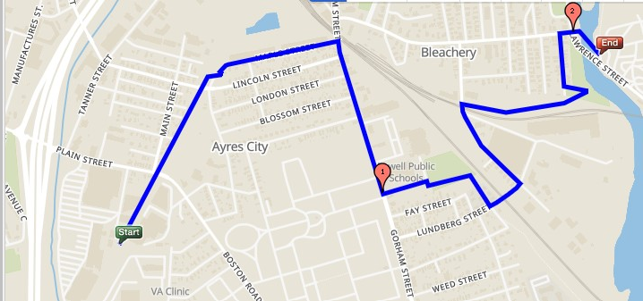
Alternate BFRT-Greenway Idea 6/27/2023
RR Bridge Removed
Greenway
Old RR
Old RR
Connector
Manchester Street
Direct Route
Park
New Slope
Schools
Bolt Street
Old RR
Gorham St 3A
Target
Connector
<-BFRT
Cross Point
Scale: See mile markers
On June 27 2023, a group of us from MCA met at a school on Rt 3A in South Lowell to discuss the route between BFRT and Concord River Greenway with:
- The City Engineer of Lowell and her staff
- Peter Sutton, Bicycle and Pedestrian Program Coordinator, MassDOT
We explored a route that followed the old railroad northeast to 3A, then around two schools and a playground, over the active railroad yard on a neighborhood bridge, then through quiet streets to the Lawrence St Bridge, southern end of the Greenway.
Parks & Rec and the City are actively working on this connection, so we are just working with MassDOT to suggest another route for consideration.

Slide 39
Summary and Conclusions
At Last

Slide 40
What’s This Mean to our canal?
Opportunity for outside funding to improve and preserve the towpath as a trail, fix swampy areas
10-foot wide towpath is basically the trail substrate
Rough estimate is ~ $2M/mile, from recent Woburn Rail Trail study https://www.woburnma.gov/wp-content/uploads/2022/12/Shared-Use-Path-Feasibility-Study-Canal-and-RR-ROW-2022.pdf.
Typical Rail Trail (Woburn)

Slide 41
Why is This Important?
Multi-use trails serve bikers, walkers, runners - even commuters and school kids
Safe alternative routes, separating cars and bikes
Not just point-point lines, but a network of connected trails so users can get on and off where needed
Our local trails, existing and proposed, are part of the MassDOT Master Plan Priority List for funding to expand the Active Transportation trails network
The biggest remaining gap in the Eastern Mass trail system is the Greater Lowell area
MassDOT = MA Dept of Transportation

Slide 42
Conclusion
There are many interconnecting projects, past-present-future, to preserve ROWs and provide safe scenic trails for bikers, strollers, walkers, joggers, and runners
The Middlesex Canal towpath can provide the missing link to re-unite the two branches of the Bay Circuit Trail on their way between Duxbury and Plum Island
Like the museum, nothing done right is cheap
Basic trail to modern standards costs over $2M/mile
Years of work is needed to agitate for the federal funding needed, same as we did for the museum
Last year’s critical opportunities were:
Riverneck Road easement to get around 495 and 3 = pending
Inclusion in MassDOT and NMCOG plans = done

