Slide 1
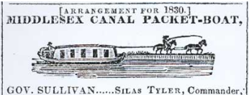
Towpaths to Trails OPENING AUTO SLIDESHOW
Opening and closing auto slide show for “Towpaths to Bike Trails R7a 20240218.pptx”
Rev 8, 2/29/2024
How the Old Canal Towpath and Other Rights of Way Can Bridge Some Gaps in Regional Multi-Use Trails
Presentation to the Quarterly Meeting
Middlesex Canal Association
18 Feb 2024
Doug Chandler
A Chelmsford Rep to
Middlesex Canal Commission

Slide 2
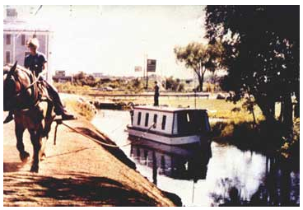
Original Use of Towpath
Woburn, just north 0f 128, recently

Slide 3
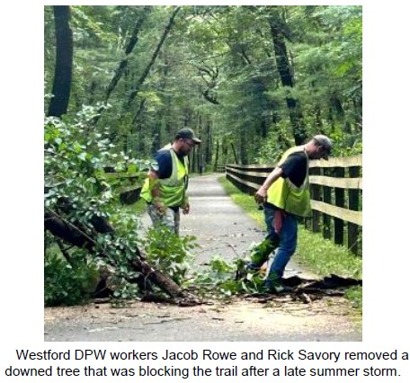
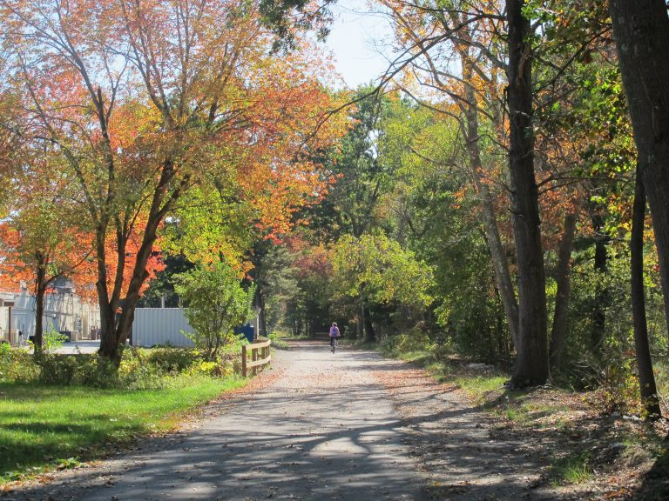
Bruce Freeman Rail Trail (BFRT)
Fall trail in Acton
Pix from https://brucefreemanrailtrail.org/
Built on abandoned RR grade
Paved
Maintained

Slide 4
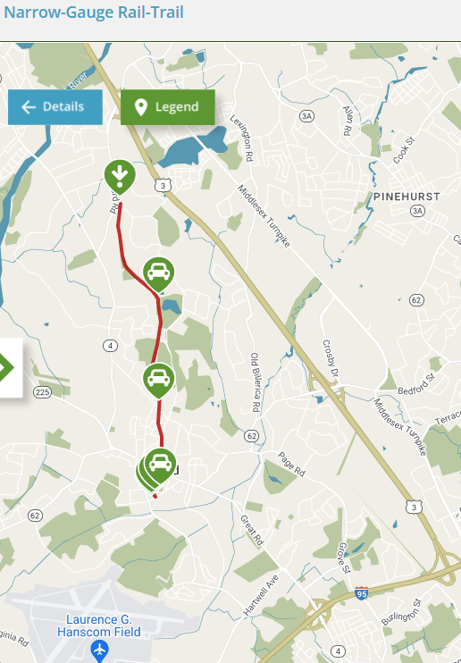
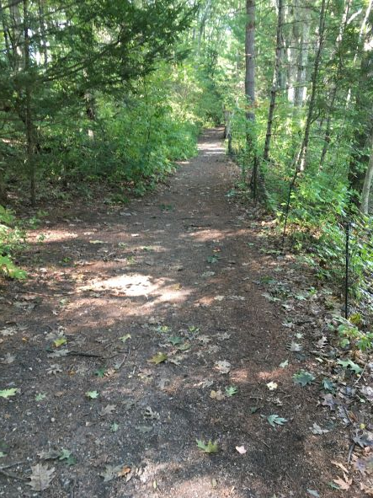
Bedford Narrow Gauge Rail Trail
Yankee Doodle to Billerica will connect here
Bedford Depot
Reformatory Trail to/from BFRT
Minuteman Commuter Bikeway from Somerville
6 miles of good unpaved trail
https://www.traillink.com/trail/narrow-gauge-rail-trail/

Slide 5
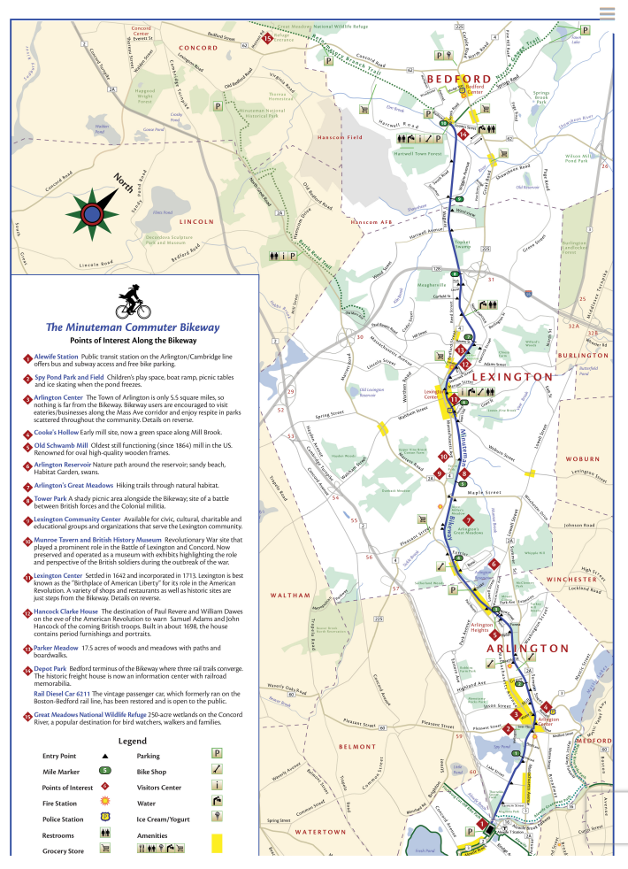
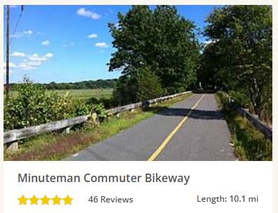
Minuteman Commuter Bikeway
Reformatory Trail from BFRT
Bedford Narrow Gauge Trail
On the old “Lexington Branch” RR
between Bedford, Lexington, Arlington, Alewife & Cambridge
Connecting to Somerville, Boston, etc
https://minutemanbikeway.org
Somerville Community Trail

Slide 6
“Reformatory Branch” Rail Trail
RR used to connect Bedford Depot to Framingham & Lowell RR (now BCT/BFRT) near Concord Prison Rotary
Good unpaved rail trail (like Narrow Gauge, not Minuteman)
East 4 mi OK between Bedford Depot and Concord Lumber
West 4 mi missing bridges over Sudbury and Assabet Rivers and paved over by prison rotary , so substituted by roads
BFRT on RR
Bike path on roads
Depot
Path on RR
Prison Rotary

Slide 7
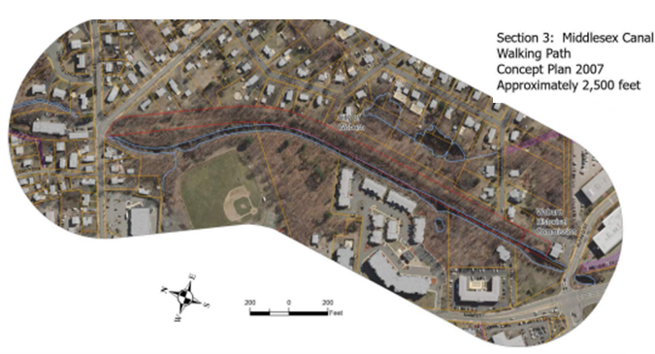
Woburn Towpath to Bike Trail
About 3 miles of Middlesex Canal towpath and subsequent railroad now being converted to trail
3
Detail
2
1
Middlesex Canal in Woburn

Slide 8
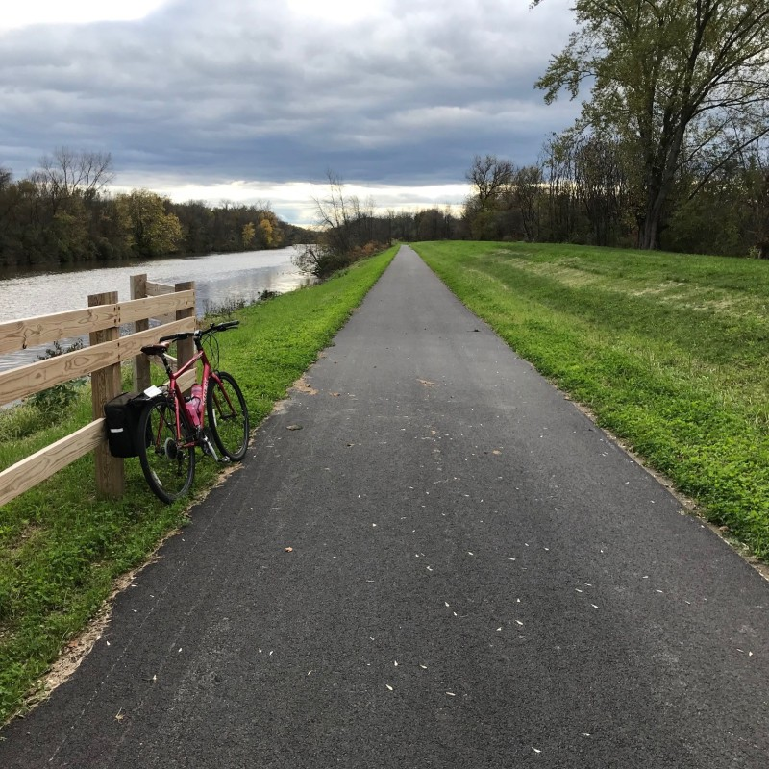
NY State Towpaths to Bike Trails
New York state is a leader in towpath trails.
They have finished most of the Erie Canal and much of the Champlain Canal, plus more in the works
Champlain Canal, NY

Slide 9
NY State Towpaths to Bike Trails
Erie Canal Trail, NY

Slide 10
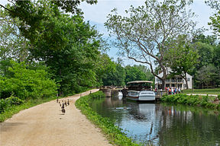
WDC & VA Towpath to Bike Trail
Chesapeake & Ohio Canal Multi-Use Trail: Bikers, strollers, joggers, runners, ducks

Slide 11
New Jersey Towpath to Bike Trail
D&R Bike-Hike-Horse trail, NJ

Slide 12
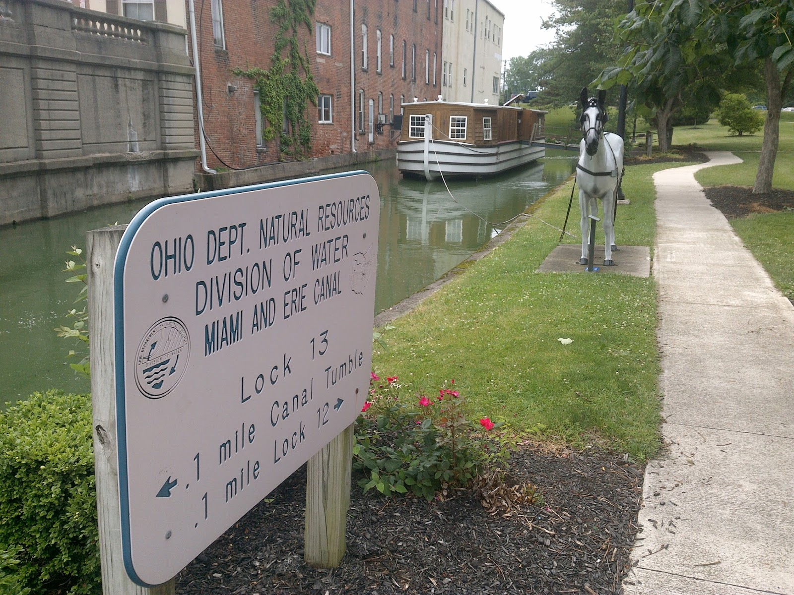
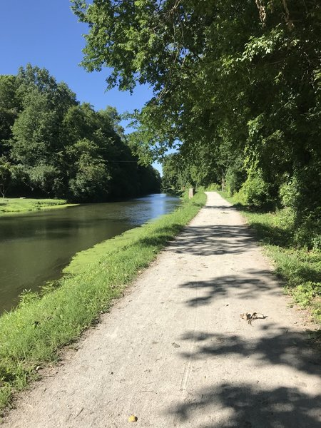
Ohio and Indiana Towpaths to Trails
Miami&Ohio lock sign and replica canal boat, OH
Monon Central Canal trail, IN

Slide 13
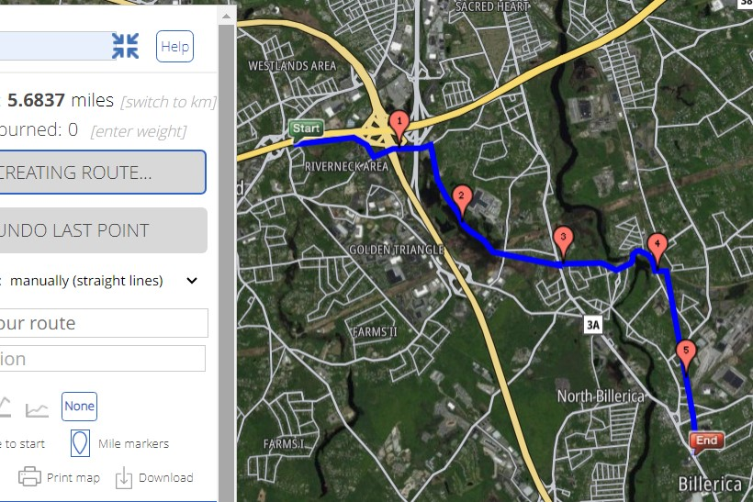
Riverneck Project

Slide 14
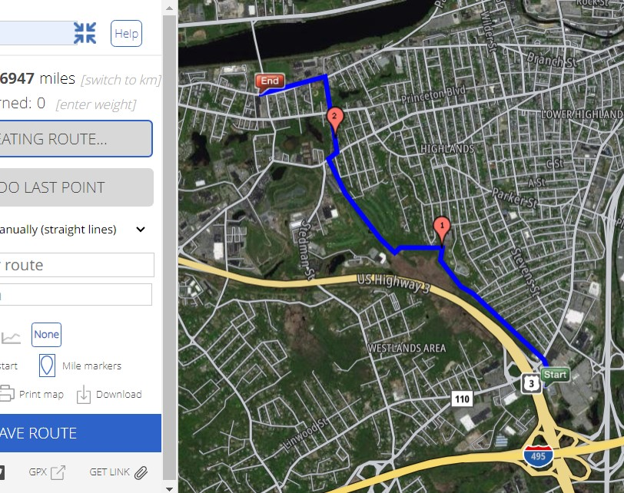
Lowell Heritage Park Project
2.

Slide 15
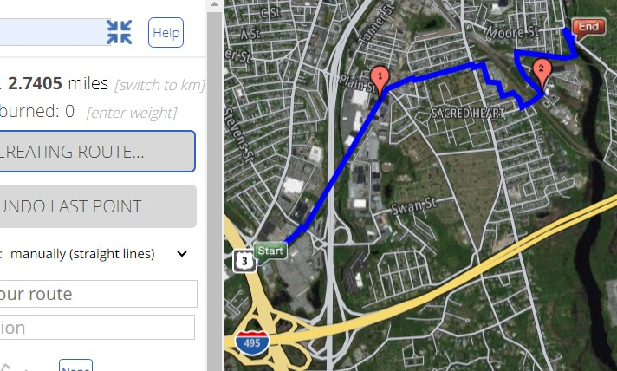
Greenway Connection Project

